Slide 1
Corrosion Management of Preaction Fire Sprinkler Systems - Mission Critical Environments
Presented By:

Slide 2
Learning Objectives
No. 1 reason automatic sprinklers activate and DO NOT control the fire is not enough water at the sprinkler
Oxygen in the air is the primary cause of corrosion in all water-based fire sprinkler systems
Understanding the chemistry and physics of the oxygen corrosion reaction is key to solving the corrosion problem
Removing oxygen from water-based fire sprinkler systems is the key to corrosion control
Galvanized piping is vulnerable to extreme corrosion
Nitrogen inerting to completely remove oxygen stops corrosion in fire sprinkler systems
Governing bodies are adopting nitrogen inerting technologies including NFPA, FM Global, US DoD, US GSA

Slide 3
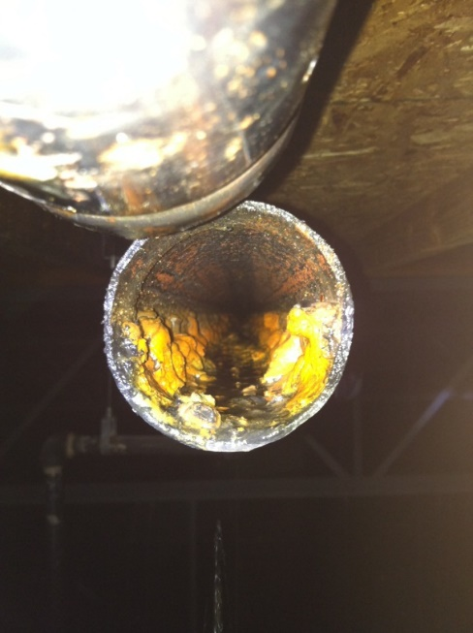
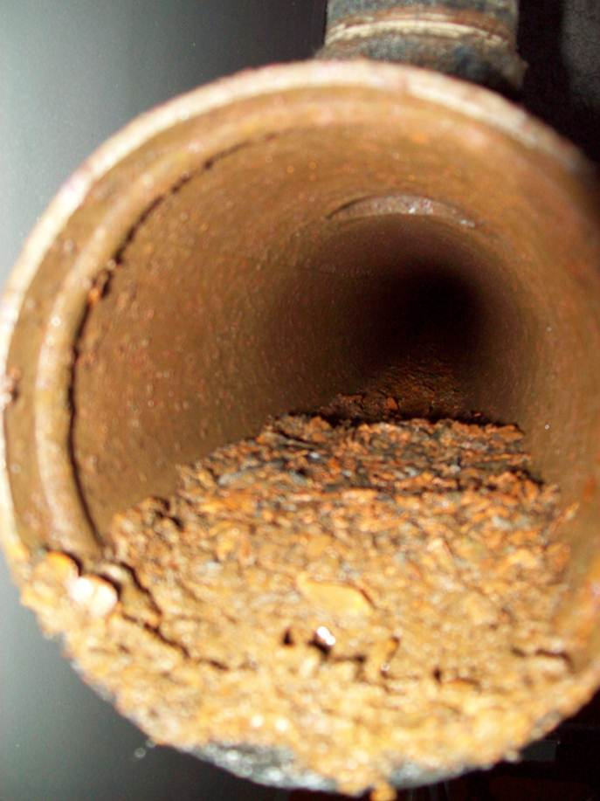
Fire Sprinkler Corrosion does not just cause leaks. Corrosion impedes water delivery to the fire!

Slide 4
NFPA July 2017 Research Report
“U.S. Experience With Sprinklers”
https://www.nfpa.org/-/media/Files/News-and-Research/Fire-statistics/Fire-Protection-Systems/ossprinklers.pdf
Sprinklers 96% effective when they operate
No. 1 cause for failure to control - System Shut Off
When Sprinklers Operate But Are Ineffective at Control
No. 1 cause (51%) - Water did not reach fire
No. 2 cause (30%) - Not enough water discharged

Slide 5
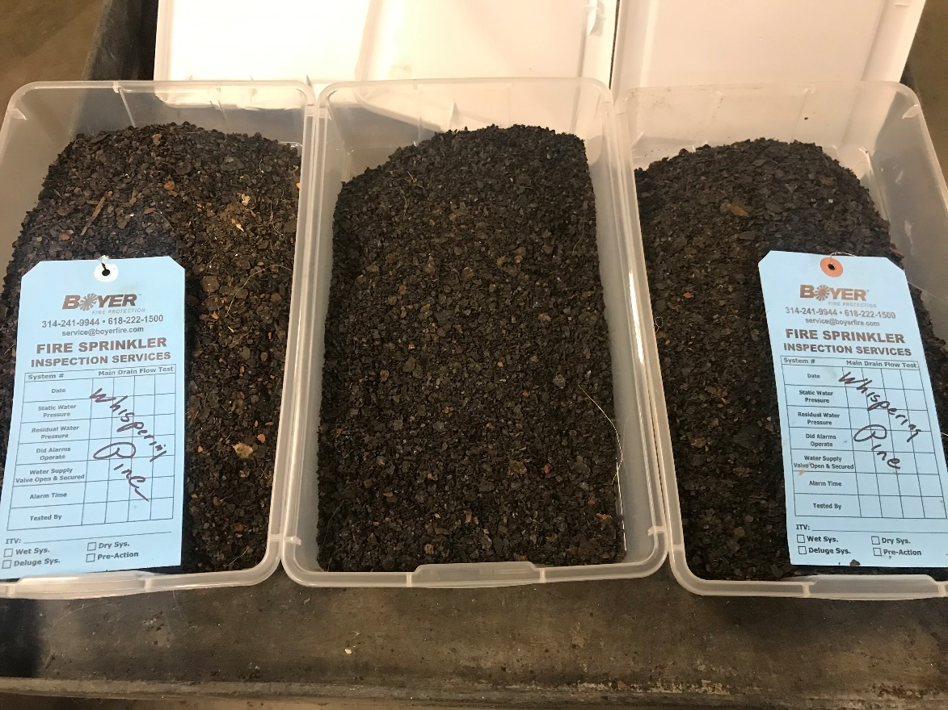
Debris from Dry Pipe Flushing!

Slide 6
Corrosion in Fire Sprinkler Systems
Question: How common is corrosion?
Answer: Virtually all water based fire sprinkler systems are subject to attack by oxygen corrosion.
It is everywhere!

Slide 7
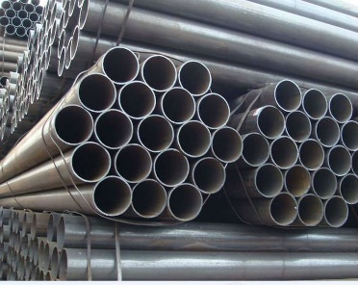
The Science of Corrosion
Oxygen is the Primary Cause of Corrosion in Sprinkler Systems Atmospheric Air: ~21% O₂
Liquid Water
Oxygen
Rust (Iron Oxide Fe₂O₃)
Steel Piping

Slide 8
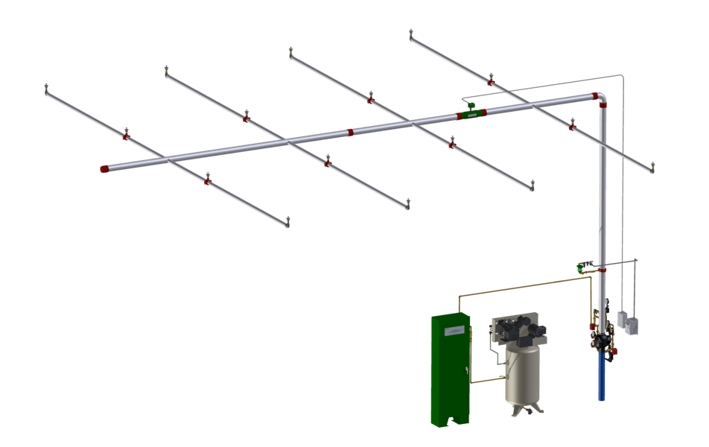
Preaction Systems – An Overview
Preaction System: Sprinkler system employing closed automatic sprinklers connected to a piping system containing pressurized supervisory gas used in conjunction with a supplemental detection system
Supervisory gas typically compressed air
Two (2) discreet events must occur to release water into system piping (i.e. smoke + heat detection)

Slide 9
Presence of Water in Preaction Systems
ALL PREACTION SYSTEMS TRAP WATER!
Water Sources:
Condensate from compressed air source
Warm, saturated air input to preaction system by air compressor
Hydro-testing of system
Preaction system integrity is hydrostatically tested immediately after install
Water never completely removed post-testing
Trip-testing of system
Preaction system is intentionally activated for verification that water will reach most remote point of system in required amount of time
Water never completely removed post-testing

Slide 10
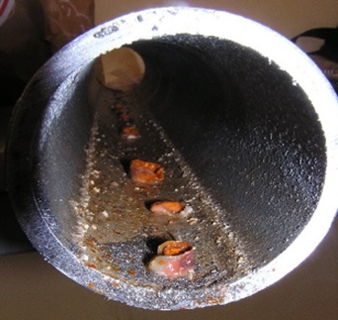
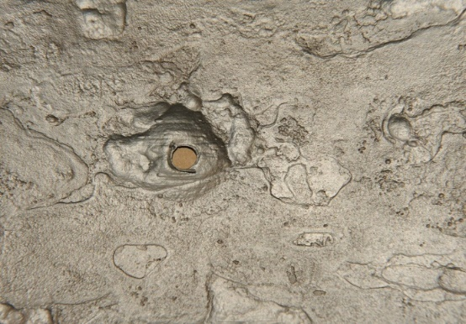
Corrosion of Preaction Systems
PREACTION SYSTEMS: THE PERFECT ENVIRONMENT FOR OXYGEN CORROSION!
Metallurgy of piping completely susceptible to corrosion
Black steel or galvanized most typically used
Unlimited source of corrosive oxygen gas
Air compressor provides constant stream of 20.9% oxygen
Trace amounts of water in piping
Corrosive activity will only occur where liquid water is present
Piping + unlimited supply O2 + small pools of water = highly localized aggressive pitting of sprinkler piping!

Slide 11
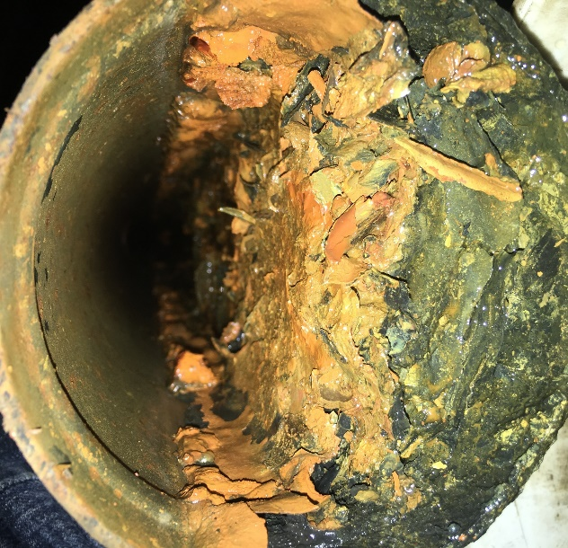
Corrosion-Related Risks
Evaluation of Risk Associated with Corrosion in Fire Sprinkler Systems
Business loss due to fire and/or water damage from leak
Mission critical facility downtime via equipment damage ($$$)
Life safety injury or loss of life
Insufficient/no flow to sprinkler heads in fire situation
Property damage or property loss
Business disruption due to cleanup
4” Preaction Main – Half Full of Deposits

Slide 12
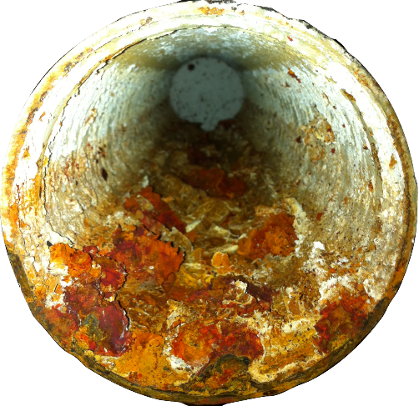
The Most Common Myths Regarding Corrosion
MIC (Microbiologically Influenced Corrosion) is the primary cause of leaks in fire sprinkler systems.
Bacteria are always present, but oxygen is the primary cause of corrosion in fire sprinkler systems¹.
Bad Water causes fire sprinkler system leaks.
Almost all fire supply water comes from fresh, clean municipal water supplies that are not chemically corrosive.
Materially Defective Sprinkler Pipe causes leaks, particularly at the weld seam.
Pipe materials used today meet or exceed ASTM requirements incorporated in NFPA 13. Root cause analysis very rarely identifies material defect as the cause of failure.
Pervasive myths regarding corrosion have hindered the implementation of effective corrosion control strategies in fire sprinkler systems.
¹ “Corrosion and Corrosion Mitigation in Fire Protection Systems” by Paul Su and David Fuller., FM Global Technical Report- July 2014

Slide 13
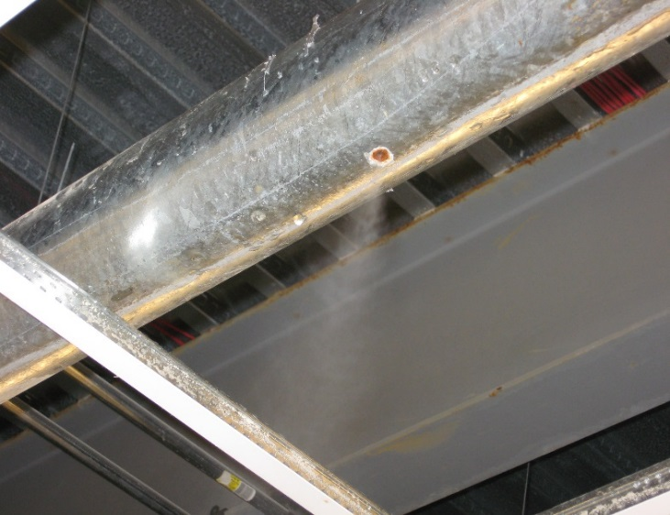
Myth - The Case of Galvanized Steel Sprinkler Pipe
Perhaps the most costly myth of all is that galvanized steel piping performs better than black steel to prevent corrosion in dry pipe and pre-action fire sprinkler systems. All dry pipe systems trap water. In areas with trapped water galvanized pipe will fail 3-4 times faster than black steel due to the highly localized nature of oxygen corrosion on galvanized material. Pinhole leaks will form in as little as two (2) years in areas where trapped water collects.
Znº ZnO Zn(OH)₂ ZnCO₃
The use of black steel pipe with a nitrogen generator as the source of supervisory gas is the most effective method of corrosion control in dry pipe and pre-action fire sprinkler systems and is supported by FM Global.¹
Galvanized Pipe Leak
¹ FM Global Property Loss Prevention Data Sheet 2-1 - Corrosion in Automatic Sprinkler Systems (October 2016).

Slide 14
Galvanized Pipe Concerns
Failures occur much faster; 50% life vs. black steel on average
Not uncommon for first pinhole failure to occur in <5 years
Failures reported less than one (1) year in service on multiple occasions
Cost – 40% higher than black steel on average
Higher cost for less corrosion resistance!
Toxicity of discharged water
High levels of heavy metal contaminant (zinc) in discharge water; way above allowable discharge limits in many jurisdictions
High zinc levels are highly toxic and possibly deadly for aquatic life

Slide 15
Options for Controlling Corrosion
Metallurgy – too expensive (copper, stainless)
Plastics – restricted by code (light hazard, residential)
Coatings – delamination complications (sprinkler plugging)
Chemical Inhibitors – ineffective, incompatible (designed for flowing systems, degrades plastics and elastomers)
Remove the Corrosive Gas – purge the oxygen

Slide 16
Key Documents Timeline
1998 1999 2001 2013 2014 2016 2017 2018 2019
NFPA 13
Biocide
Corrosion
Compatible
UFC Code
No Galv
N₂ Generator on Preaction
NACE
MIC
Pope
GSA Code
No Galv
FM Global Corrosion
Report
FM Global
N₂ Generator
Standard
NFPA 13
Vent on Wet Pipe
FM Global
Data Sheet 2-1
(Oct. 2016)
N₂ Generator
(Dry & Pre-Action)
No Chemical
Dept. of Defense
UFC3-600-01
(Nov. 2016)
N₂ Generator
(Pre-Action)
Equipment in Riser Rm
No Continuous Venting
GSA
PBS P-100
(Apr. 2017)
N₂ Generator
(Dry & Preaction)
Vent on Riser
In-Line Corr. Mon. Fail Safe Vent
NFPA 13
Nitrogen to Mitigate Corrosion
Use Approved Nitrogen Generator
NFPA 13
1st MIC
Mention
FM Global
Data Sheet 2-1 MIC & Chemical
Treatment
Dept. of Defense
UFC3-600-01
(Mar. 2018)
N₂ Generator
(Dry)

Slide 17
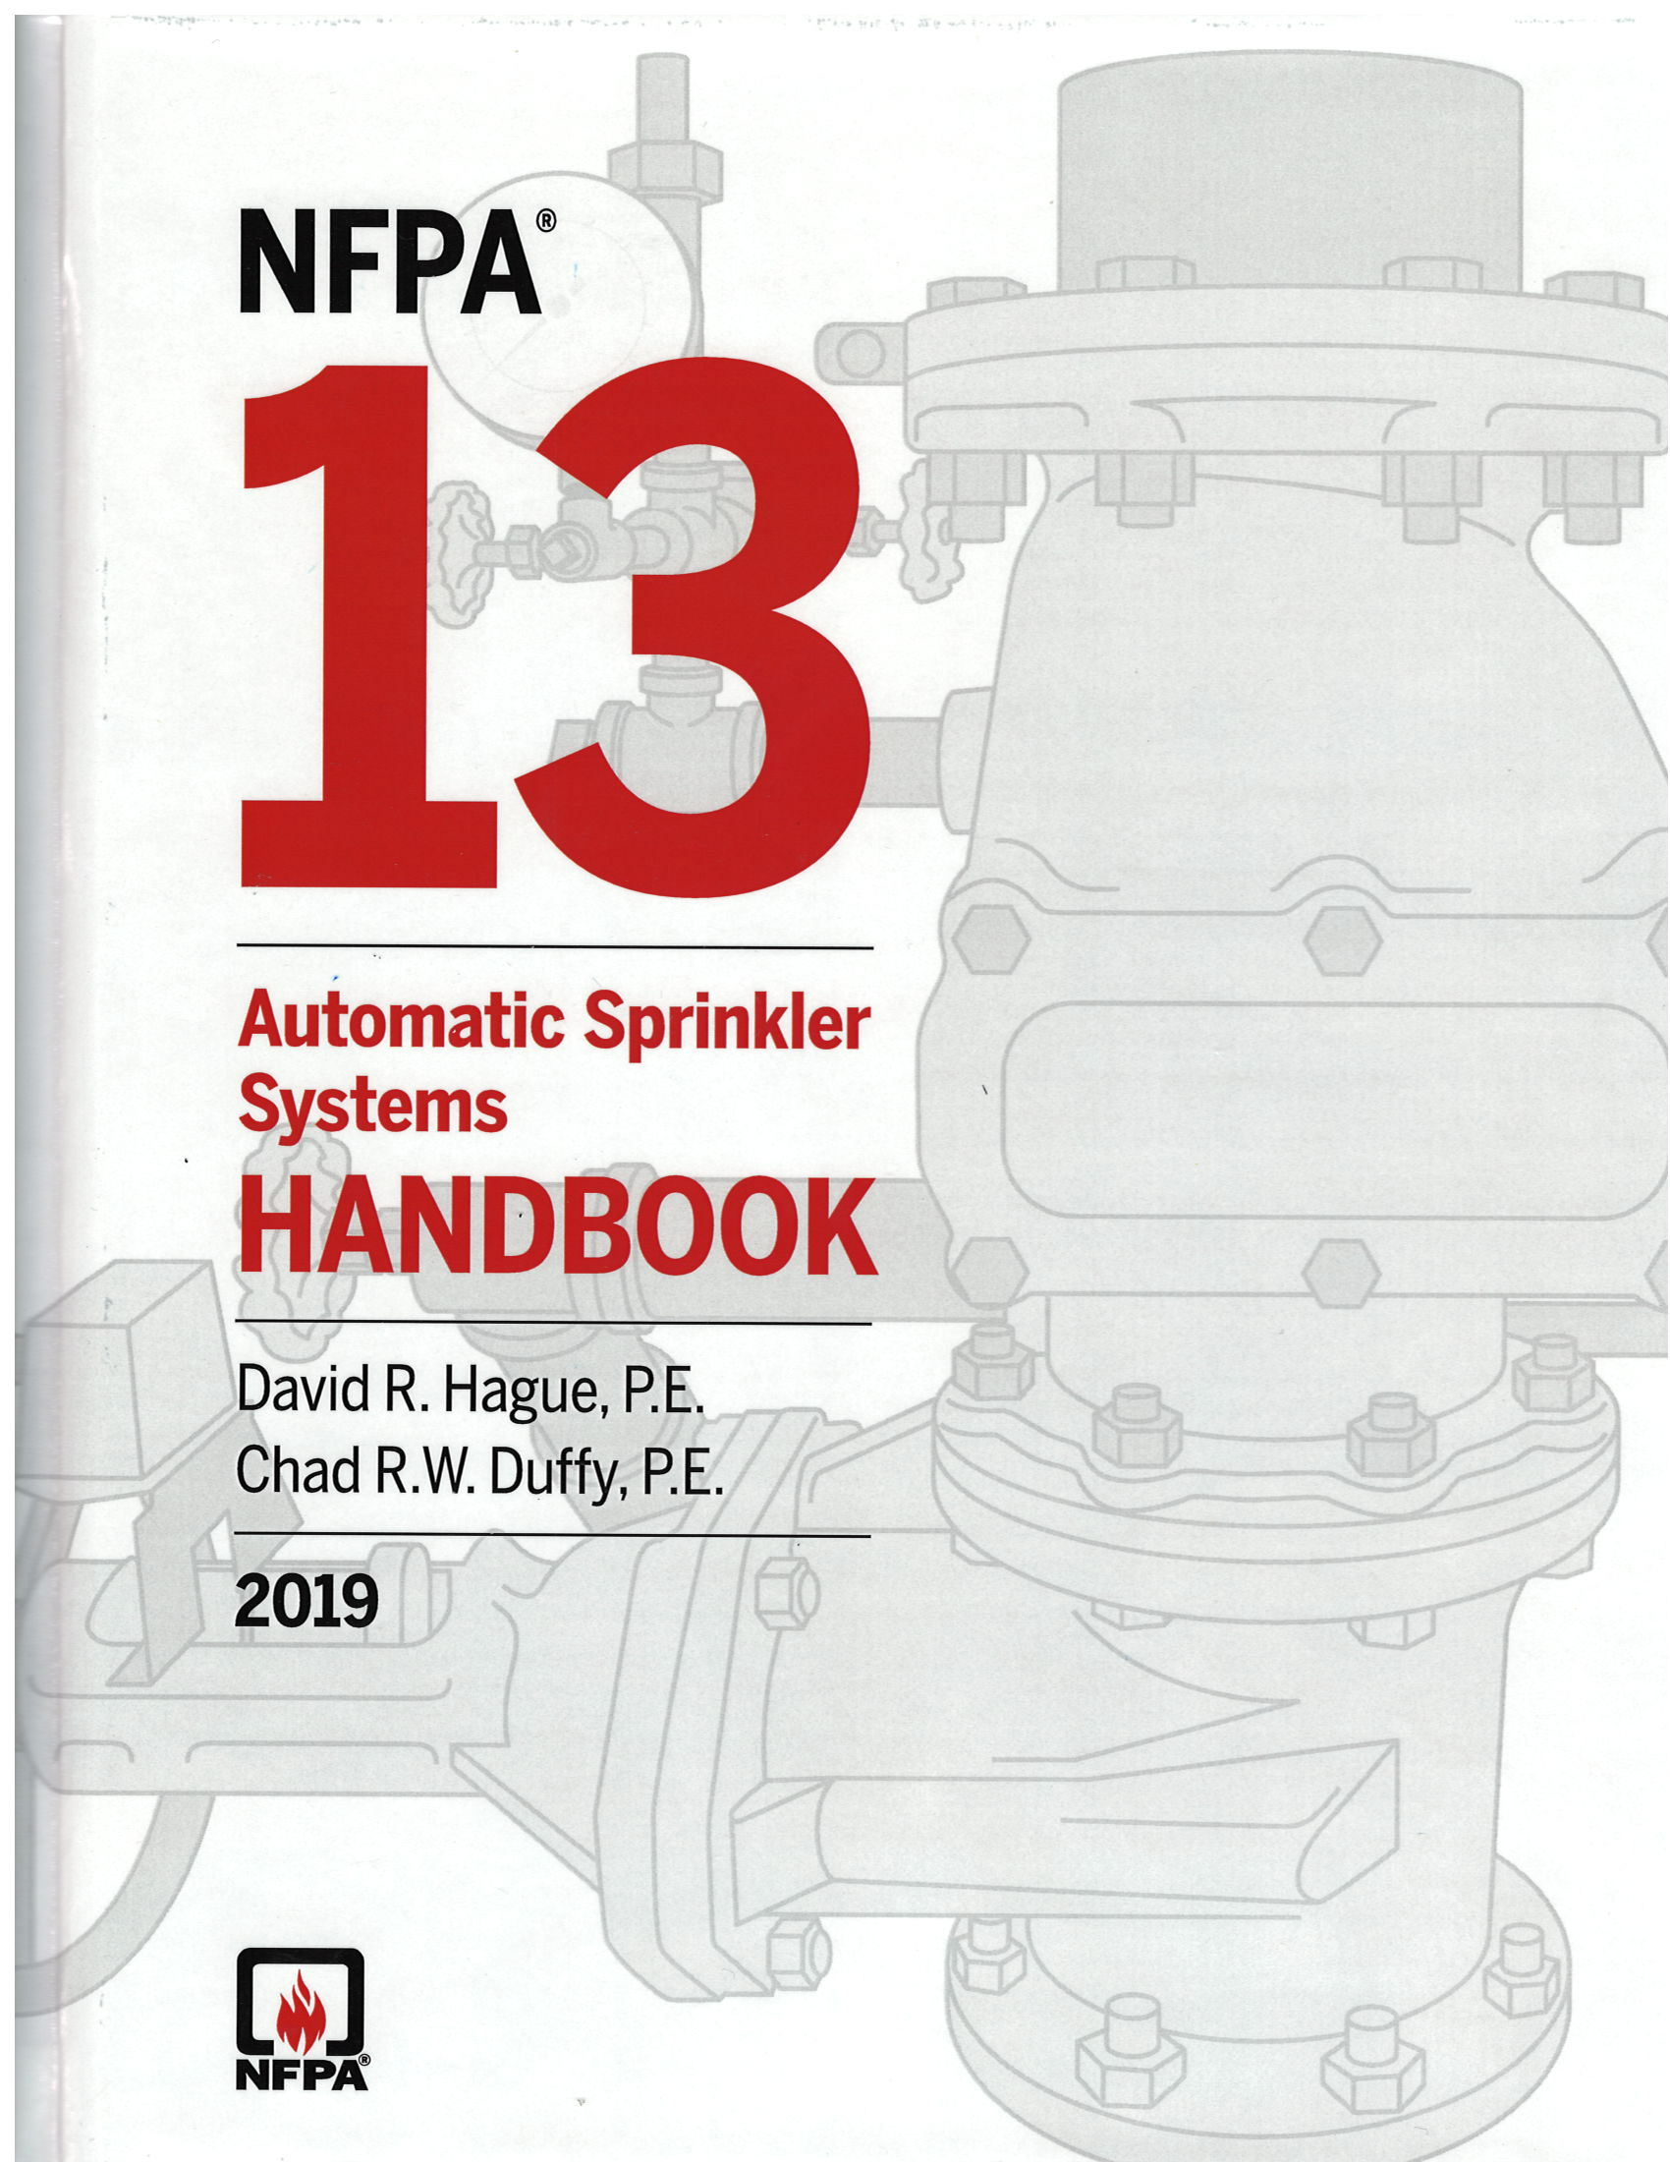
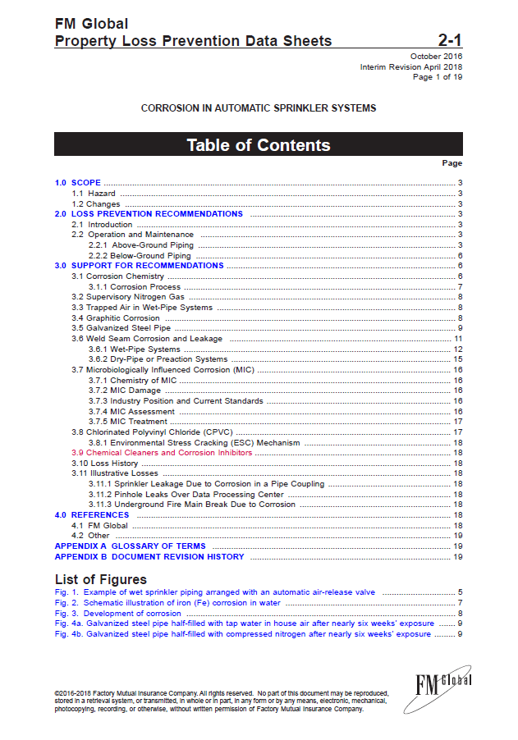
Key Documents
NFPA 13 – 2019 Edition
Fill dry-pipe or preaction systems with nitrogen as a supervisory gas to mitigate against corrosion
When using a generator, use an approved nitrogen generator
Where listed bacterial inhibitors and/or corrosion inhibitors are used they shall be compatible with system components as well compatible with each other
A single air vent shall be provided on each wet pipe system utilizing metallic pipe
FM Global 2-1 Data Sheet – April 2018
Pressurize system using FM Approved nitrogen generator
Black steel acceptable if nitrogen generator used throughout life of system
Chemical Cleaners and Corrosion Inhibitors can result in accelerated sprinkler corrosion or restricted orifices

Slide 18
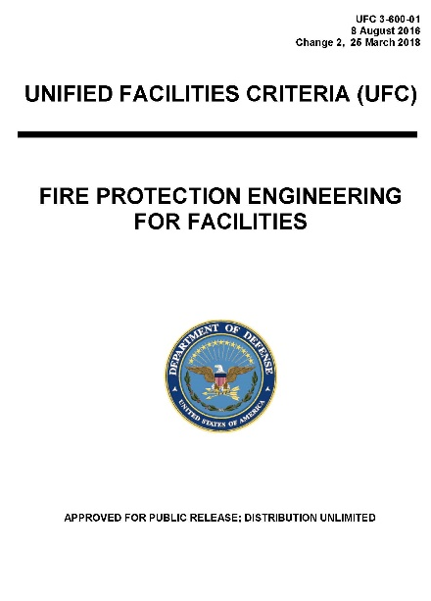
Key Government Documents
DoD Unified Facilities Criteria UFC 3-600-1 – March 2018
When nitrogen is used, a C-factor of 120 is permitted
Black steel must be used for addition, repair or relocation of existing systems
All nitrogen generation equipment must be installed in riser room
Process involving continuous venting is not permitted
GSA PBS-100 Facilities Standard – July 2018
Dry-pipe sprinkler systems must incorporate nitrogen inerting process
Galvanized sprinkler piping is not permitted

Slide 19
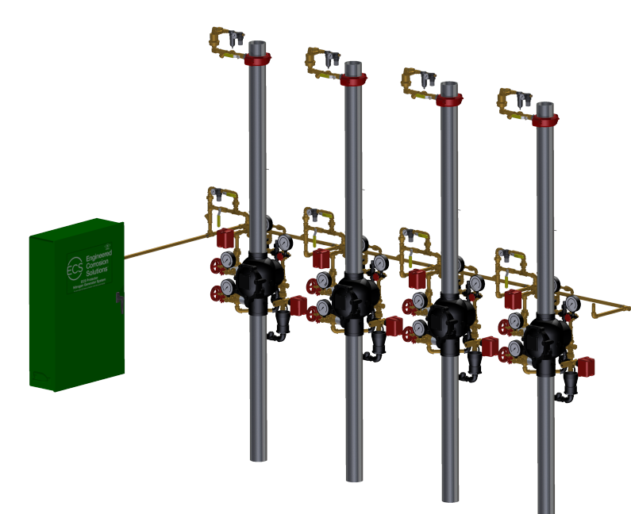
Nitrogen for Dry Pipe Systems
Essential components for dry pipe systems:
A continuous source of nitrogen gas at 98%+ purity – nitrogen generator
An oxygen removal vent to facilitate removal of oxygen from the dry system piping
A “Fill and Purge” breathing protocol to facilitate removal of oxygen from the dry system piping (ECS Only)
Vent at Riser
Nitrogen Generator

Slide 20
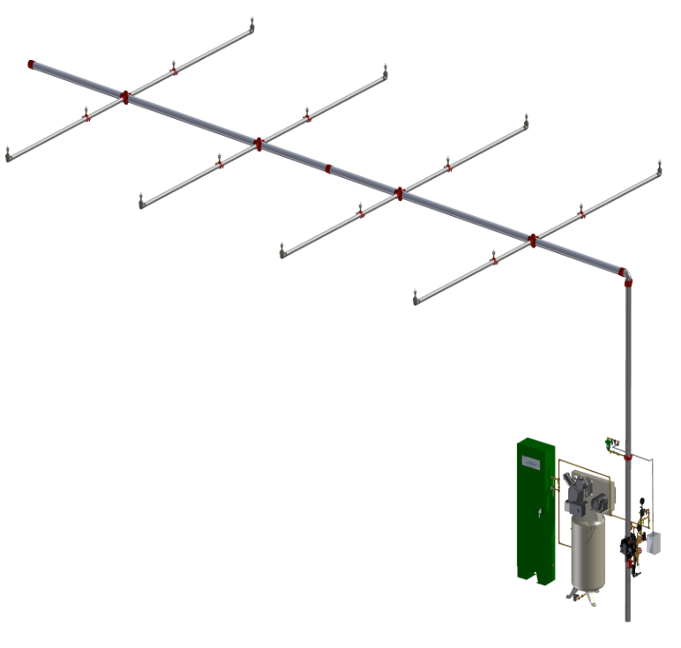
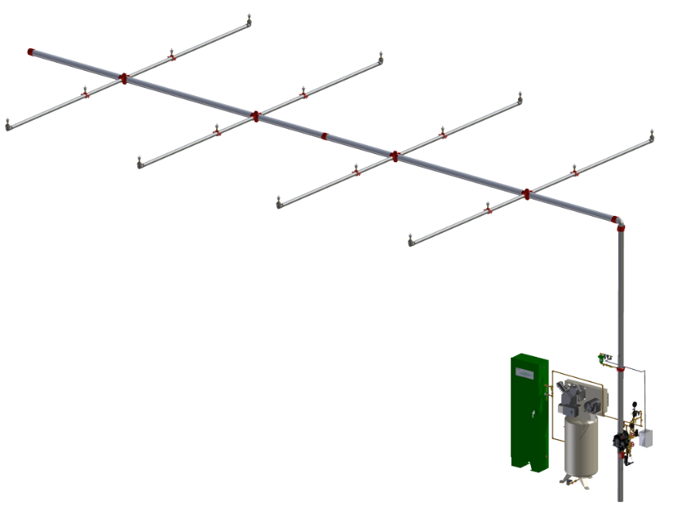
“Fill and Purge” Breathing Method
ECS Only
Fill Cycle
Purge Cycle
All Equipment Including Vent Installed in Riser Room
Dynamic Mixing of Gas - Homogenization of Atmosphere
Fill - Nitrogen Gas Throughout Piping network, No Matter the Complexity
Purge - All Gas Moves Towards the Vent
Sequential “Fill and Purge” Cycles Removes All Oxygen Gas Resulting in Piping Network Nitrogen Inerted
Compatible with all systems (low pressure and high pressure)

Slide 21
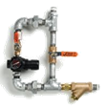
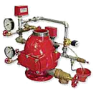
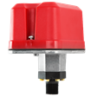
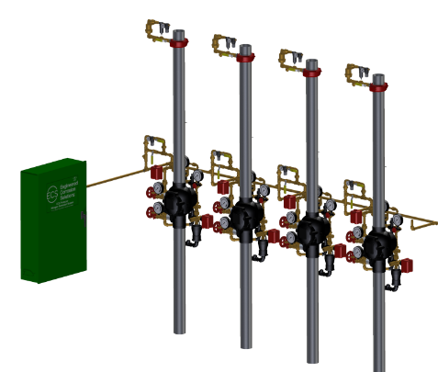
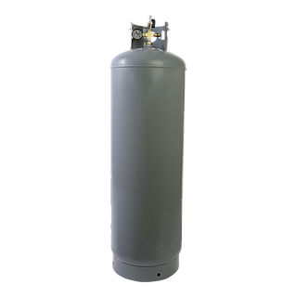
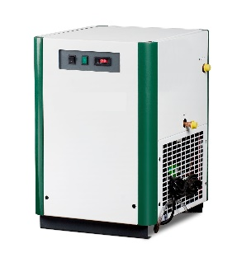
Dry Pipe Nitrogen Inerting (DPNI) Process
Dry/Pre-action “Fill and Purge” Breathing with Nitrogen
(U.S. Patent 8,720,591 )
Breathing Range
Trip Pressure
PGEN Cut-In Pressure
System AMD Setting
PGEN Cut-Out Pressure
Low Air Alarm
ECS Fill & Purge Breathing
3-5 psi pressure range
Above low air alarm/trip pressures
NO Nitrogen Storage Tank Required
NO Compressed Air Dryer Required
All Equipment Installed in Riser Room

Slide 22
Fill and Purge Breathing vs. Constant Pressure Venting
 | “Fill and Purge” Venting | Constant Pressure Venting
Supervisory Gas Pressure | Digitally Controlled Fluctuation | Static
Vent Location | Riser Room | Remote (Over Protected Area)
Gas Mixing | Throughout | Poor
Oxygen Removal | Complete | Partial

Slide 23
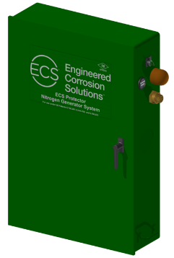
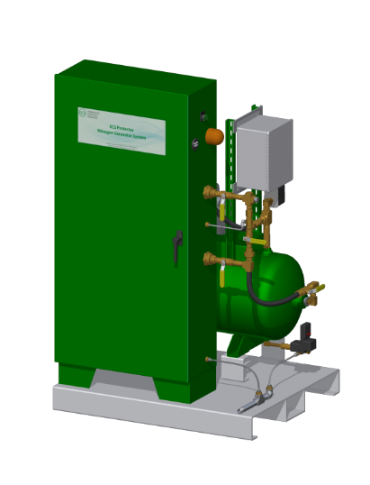
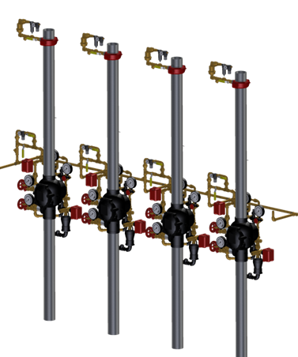
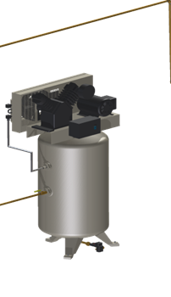
Nitrogen Generator Basics
Nitrogen generators can serve one or more systems from a single location.
Available in wall-mount, skid-mount, or stand-alone configurations.
Wall-Mount
Skid-Mount
Stand-Alone

Slide 24
Nitrogen Generator Features
Important Nitrogen Generator Features
FM Approved (Standard 1035)
UL Listed (UL 508A)
Vent installed at the riser (ECS “Fill and Purge” Breathing Only)
No nitrogen storage tanks or refrigerated air dryers (ECS Only)
Standard alarm signals
Air bypass mode
Excessive runtime/leak monitoring
Standard monitoring points
Nitrogen generator loss of power
Air bypass mode
Nitrogen generation mode
Nitrogen supply line pressure
Excessive runtime/leak monitoring

Slide 25
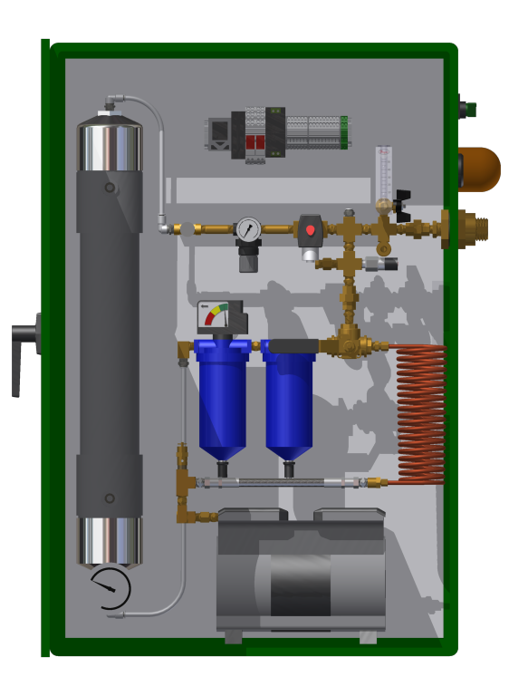
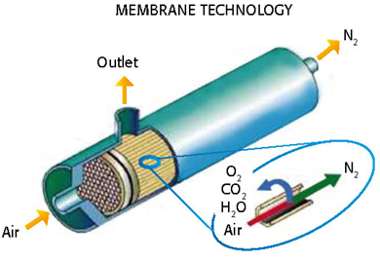
How Nitrogen Generators Work
A high pressure air compressor (100+ psi) provides feed air to a gas separation membrane. The membrane filters out smaller oxygen molecules as waste gas and delivers larger nitrogen molecules (98+%) as end product gas.
Gas Separation Membrane
Wall Mount
Air Compressor

Slide 26
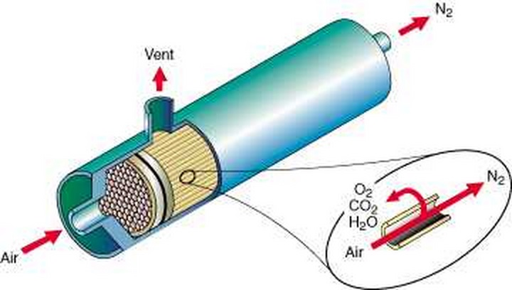
Membrane Gas Separation
Functional Characteristics
“Selective permeation”
Oxygen = “Fast Gas” (smaller, more soluble molecules)
Nitrogen = “Slow Gas” (larger, less soluble molecules)
Efficiency increase with temperature increase
Advantages
Purity and flow rate easily adjustable
No storage tank required
Long service life (15-20 years!)
No maintenance to membrane required during life
Compact
Quiet
Removes water vapor (no air dryer required)
Disadvantages
Lower flow rates at higher nitrogen purities
TECHNOLOGY TRUSTED BY THE FAA FOR IN-FLIGHT NITROGEN INERTING OF FUEL TANKS IN COMMERCIAL AIRLINERS!

Slide 27
Life Expectancy – Compressed Air vs. N2
Sprinkler Life Expectancy - Compressed Air
Average time before first reported failure:
Black Steel Sch. 10: ~10-20 years
Black Steel Sch. 40: ~25-30 years
Galvanized Sch. 10: ~5-10 years
Galvanized Sch. 40: ~15-25 years
~10-30 mils/year corrosion expected under compressed air
Sprinkler Life Expectancy – Nitrogen
Corrosion rate: ~1-5 mils/year under nitrogen inerted atmosphere
Expect 6X-8X multiplier on system service life

Slide 28
Cost Comparison – Compressed Air vs. N2
Installation Costs
Black Steel: $2.00 - $4.00/sq. ft.
Galvanized: $3.00 - $5.00/sq. ft.
Corrosion control cost add: $.25 - $1.00/sq. ft.
Costs stay on lower end with larger facilities (100,000 sf+)
Black Steel + Nitrogen = a superior less expensive option to traditional galvanized compressed air preaction systems!!

Slide 29
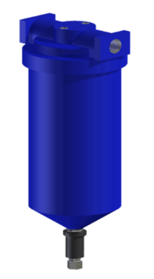
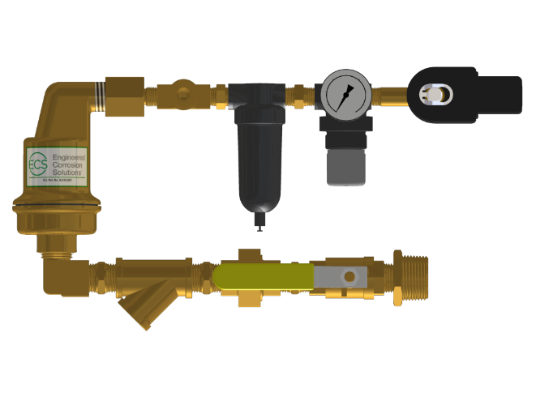
Equipment Maintenance/Service Life
Air Compressor
Provides supply air for N2 generation
Filter and oil change annually OR every 500 hours
Service kit cost: $185
Nitrogen Generator
Annual compressed air filter change, between 2-4 filters depending on model
Gas separation membrane used by ECS is rated for 20-year service life
Filter kit cost: $295
Oxygen Removal Vent
Annual inspection of Y-strainer for blockage
Annual inspection of in-line filter for debris
2
1
4
3
2
1

Slide 30
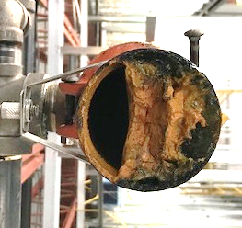
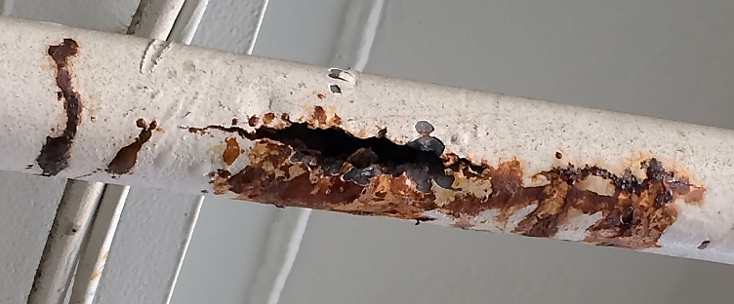
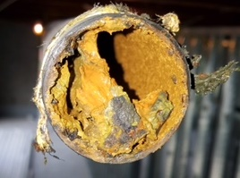
Corrosion Monitoring
What is Corrosion Monitoring?
Implementation of devices used to give real-time corrosion data within Fire Sprinkler Systems
Why is Corrosion Monitoring necessary?
Early warning to prevent risk
Validates effectiveness of corrosion management system
Old Methods
Coupons
Riser-mounted - Corrosion simulated; not real-time
Remotely inserted - Not continuously monitored
Wait for leaks
Leak occurrences not linear
New Methods
In-Line Corrosion Detectors

Slide 31
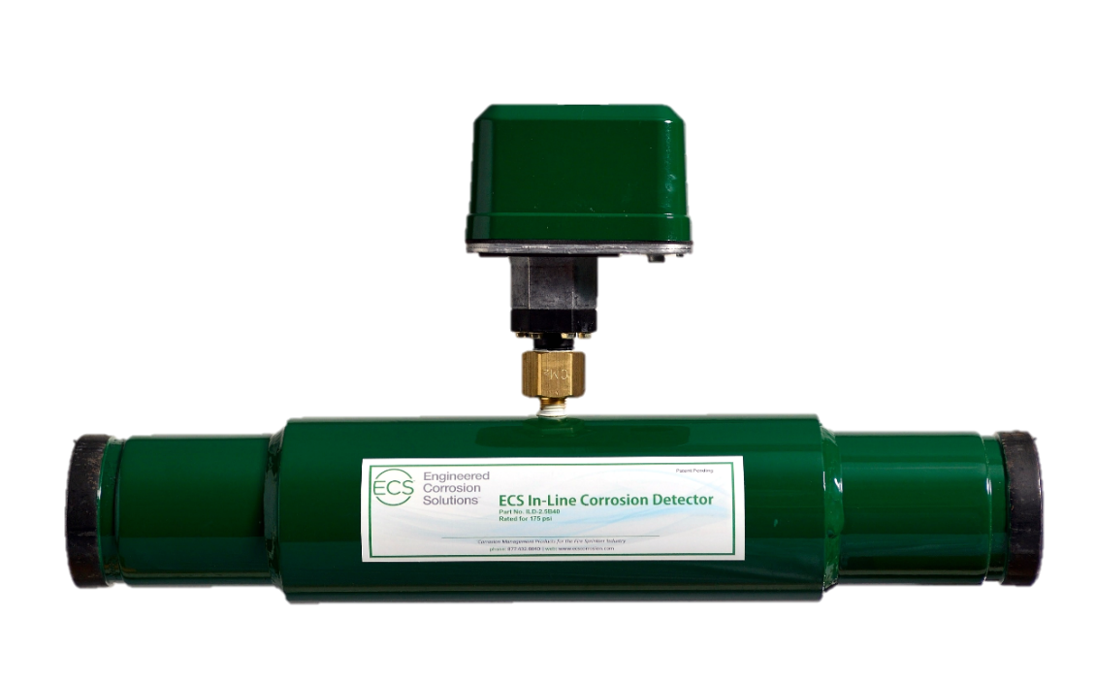
In-Line Corrosion Monitoring Device
Important Features
Only UL Listed (UL 2987) method for monitoring corrosion in fire sprinkler systems
For Dry Pipe, Pre-action and Wet Pipe Systems
Complete 360º Coverage of Corrosion Detection
Continuous monitoring of corrosion activity inside fire sprinkler system
Installed where corrosion is most likely to occur
Low point mains in dry systems
High point branch lines in wet systems
Local and remote monitoring
Remote Test Station included
Thin walled section creates a pressure chamber

Slide 32
CONTACT US
Contact ECS for 24/7 engineering and technical support
Office business hours: Monday thru Friday, 8 AM - 5 PM (central time zone)
Technical information available online
CAD files available upon request
(314) 432-1377
info@ecscorrosion.com
www.ecscorrosion.com

