Slide 1
Minimize Fire Risk and Maximize Recovery

Slide 2
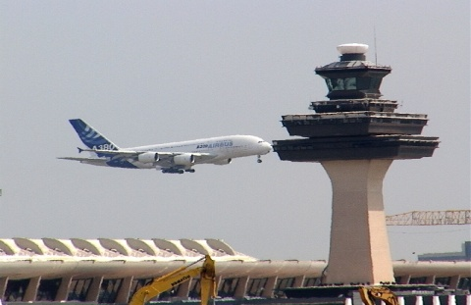
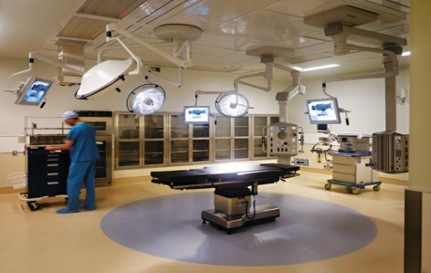
Defining Mission Critical
High Value of Business Operation
You stand to lose significant income
Has Strategic Existence
Your product or service becomes unavailable
People Depend on It
The public, your customers, and/or employees are impacted
Regulatory Compliance is Impacted
Consequences may be fines or other penalties
Notes:
Interruption causes negative impact on conducting your business
Loss of revenue
Loss of service
Risk legal or regulatory compliance
Jeopardize health or
Produce a loss of life

Slide 3
Defining Mission Critical
Is there any redundancy to your operations?
Would a fire impact your facility significantly?
Is there an increased fire risk because of what happens in the facility?
Notes:
Admittedly it is a blurry line between mission critical and non-mission critical. It largely depends on your organization's outlook on what it does.

Slide 4
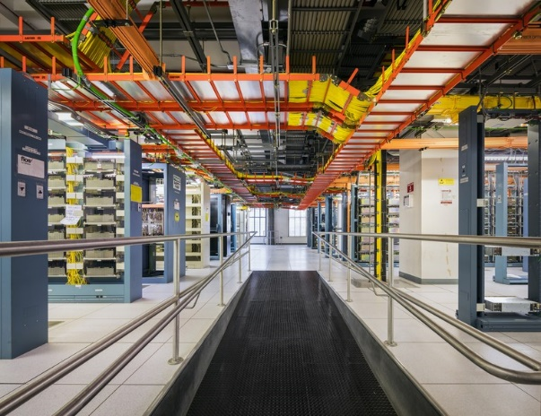
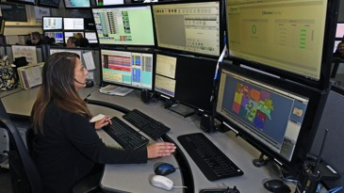
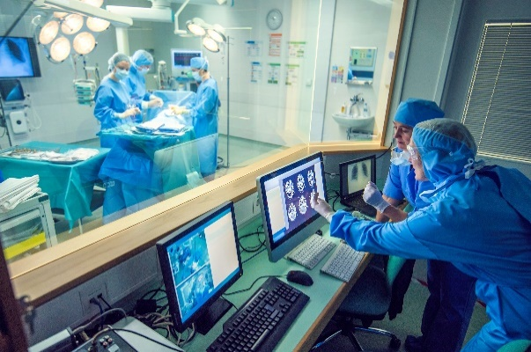
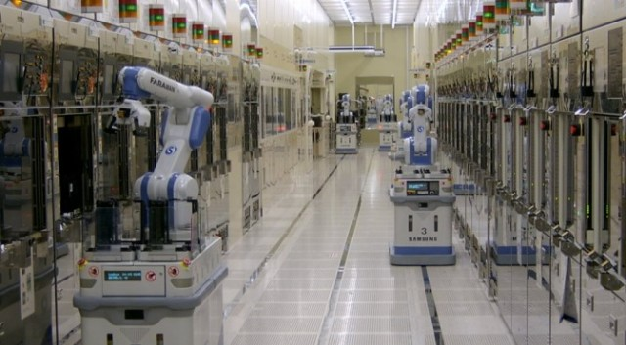
Mission Critical Facilities
Notes:
Some of the classic examples are
Military and space applications – The original mission critical where the term was coined
Data centers and telecommunications facilities
High cost of downtime
High equipment cost per room
Protection of communications pathways essential to the public and to commerce
Outages (especially fires) are usually a big news event and hurt brand image
There are usually one or two fires in this category each year that make the news but many more smaller events that don’t
Public safety buildings and dispatch centers
Essential to providing public safety services
Hospitals
Are different because of non-ambulatory patients in the hospital
Services are essential to public health
Fires are usually big news events
Loss of heath records can cause a problem with that industry’s regulatory compliance
Laboratories
For many reasons depending on what’s happening in the laboratory
But labs are important because a fire could destroy one of a kind research that would take years to recreate or discover
High-Tech Manufacturing
Fires can impact the supply chain for goods and services the public benefits from
Impacts revenue for the business

Slide 5
Mission Critical Possibilities
Military and Space
Data Centers
Telecommunications
Public Safety
Hospitals / Healthcare
Research Laboratories
High-Tech
Semiconductor
Transportation Infrastructure
Power Generation
Utility Buildings
Oil and Gas
Chemical Facilities
Industrial
Manufacturing
Notes:
Some other facilities
Transportation Infrastructure
Fires in facilities can impact thousands or even hundreds of thousands of people
Remember some of the airline related fires of the past few years? No one is happy with the airlines when there are cancellations
Power Generation facilities
High cost of downtime – Unplanned outages can affect a region
High equipment cost
Used to frequent fire events
Utility Buildings
Broad and growing range of utilities considered public utilities
Provided for public consumption and use
Fires affecting these facilities can involve chemicals – usually bad outcomes
Oil, Gas and Chemical
Fires in these facilities can lead to explosions
There’s a great book called “Disasters Man-Made” about the history of industrial fires and many of the events chronicled in the book involved loss of life
Some of these fires have caused environmental concerns post-fire
Manufacturing
Some manufacturing and industrial facilities can be considered mission critical by the businesses that own them
Fire protection is required because of the hazards that are present
The high number of fires that have been experienced
Or the loss of revenue that could be or even have been experienced

Slide 6
The Common Thread
MISSION CRITICAL FACILITY
FIRE PROTECTION

Slide 7
Occupancy Codes – MCFP
NFPA 37 – Combustion Engines and Gas Turbines
NFPA 45 – Laboratories
NFPA 75 – Data Centers
NFPA 76 – Telecommunications Facilities
NFPA 99 – Healthcare Facilities
NFPA 232 – Protection of Records
NFPA 318 – Semiconductor Manufacturing
NFPA 409 – Aircraft Hangers
NFPA 850/851 – Power Plants

Slide 8
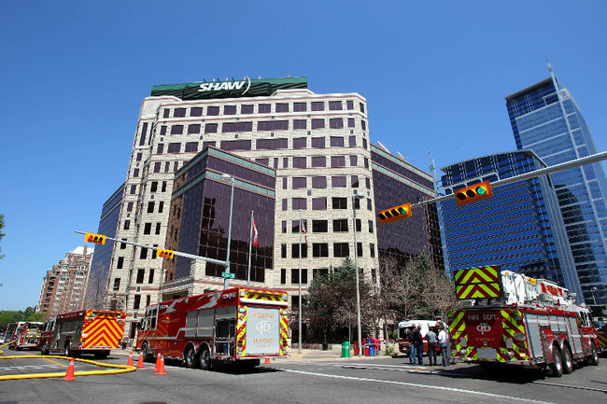
Shaw Data Center Fire – 2012
What Actually Happened…
Electrical transformer power and explosion
Destroyed both primary and emergency power
All connected equipment shut-down
Sprinklers operated for 2+ hours
Soaking other data centers below
Approximately 3 Days of Downtime
30,000 customers without phone service
Even more experience internet service outage
Shut down 911 services
Shut down 3 radio stations
Shut down 1 bank’s ATM network
Shut down all Alberta Hospitals data comm.
Delayed 100s of surgeries for 3 days
“It’s daunting because, in my practice, I have a lot of frail, sick, elderly folks. I have organ transplant recipients and people on dialysis.”
- Surgeon Impacted by Outage
Notes:
Destroyed both Primary and Emergency Power
- When Emergency Generators kicked in to restore power, they detected a short and immediately shut down.
- All connected equipment shut-down

Slide 9
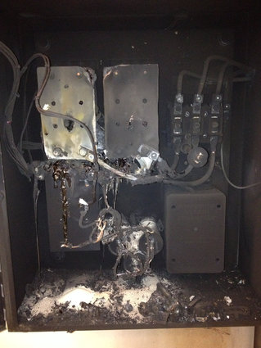
Iowa Legislative Center Fire
February 18, 2014
Minor fire event in State owned data center
Well documented
FM-200 system discharge with extinguishment
Electrical fire in surge suppressor cabinet
16 hour outage
All power shunted to IT and HVAC
Notes:
Lessons learned centered around being prepared for a full shutdown and associate restoration or switchover to a secondary data center.

Slide 10
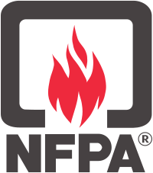
Data Center Fire Reporting
National Fire Incident Reporting System (NFIRS)
Input is by fire departments
Limited investigation and knowledge of DC environment
National Fire Protection Association
One-Stop Data Shop
Annual NFPA fire experience survey
March 2012 Report – “Computer Rooms and Other Electronic Equipment Areas”
Insurance Companies
Limited to large dollar loss fires
No industry-wide report
Many DC fire incidents go unreported

Slide 11
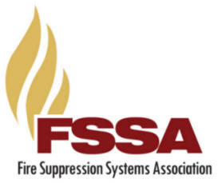
2016 FSSA Survey – DC Fires
Fire Suppression Systems Association
Represents installers and manufacturers of suppression systems
20% of installer members responded
Representing 25,000 clean agent suppression systems installed in Data Centers
Actual installed base is much larger
0.5% of installed systems have operated to extinguish a fire in a DC

Slide 12
Fires in Data Centers and Telecom ORR’s Experience
Notes:
Since January 1, 2015 there have been

Slide 13
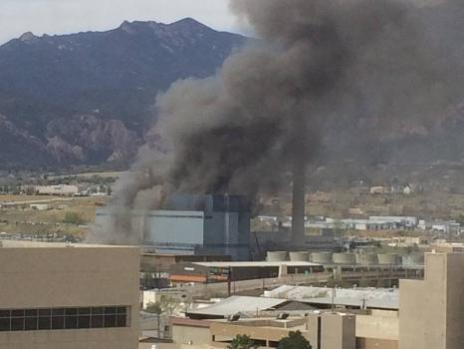
Drake Power Plant Fire
Colorado Springs, CO – May 4, 2014
Fuel-fed fire caused by lubrication oil spray
120 firefighters
23 fire apparatus
3 hours of firefighting
3 turbines damaged in fire
Notes:
Pressurized oil sprayed on to hot steam pipes causing a massive fire. 120 fire fighters with 23 fire apparatus responded and the fire was declared under control after 3 hours of manual fire fighting. Crews continued securing hot spots for several more hours.
Because of the loss of function of the power plant due to the fire, the utility is seeking a 7.4% rate increase from consumers.

Slide 14
Drake Power Plant Fire
22,000 customers without power for 40 minutes
Restored to operation 10 months after
Temporary rate increase approved for customers to pay for purchase of temporary power
Notes:
Pressurized oil sprayed on to hot steam pipes causing a massive fire. 120 fire fighters with 23 fire apparatus responded and the fire was declared under control after 3 hours of manual fire fighting. Crews continued securing hot spots for several more hours.
Because of the loss of function of the power plant due to the fire, the utility is seeking a 7.4% rate increase from consumers.

Slide 15
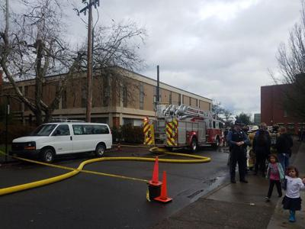
Laboratory Fire – Oregon State University
Burt Hall – Keck Laboratory at OSU – Nov 28, 2018
Fire started inside a scientific microwave oven
Significant lab damage on
2nd floor
Water damage to 1st floor under the lab
Smoke damage to labs on 3rd floor compromising equipment accuracy
Notes:
Affected the College of Earth, Ocean and Atmospheric Sciences
Affected a quarter of all faculty research
Two months later (as of January 2019) they were still evaluating the impact on research

Slide 16
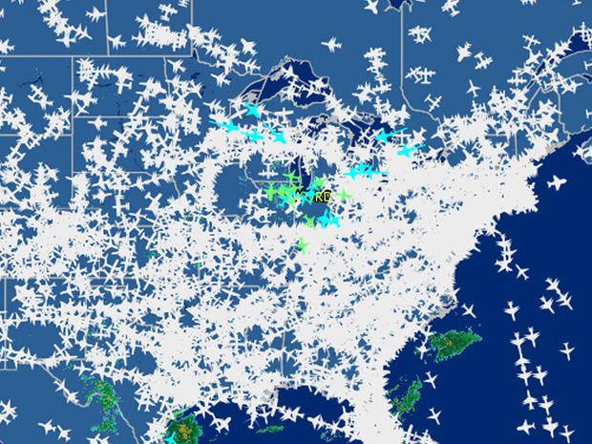
Chicago ARTCC Fire
Arson fire on September 26, 2014 at 5:20 am
Contract employee set a fire in the facility’s data center
Caused communications loss for flights in air
5000 flight cancellations
Workload was routed to other regional centers
ARTCC reopened on October 13th

Slide 17
Cost of Downtime Formula
Lost Revenue
Lost Productivity
Recovery Costs
+ Intangible Costs
Cost of Downtime

Slide 18
Cost of Business Interruption
Manufacturing Downtime
2005 auto manufacturer survey $22k/minute
Based on business type and size
Nielsen Research paid for by Advanced Technology Services
IT Cost of Downtime – ITIC 2017
Exceeds $300,000 per hour – 81% of respondents
33% reported $1mil to $5mil per hour avg.
Regulated verticals reported > $5mil/hr.
Business Interruption Insurance is Available
Available, but not common – costly
Can cover loss to tangible items
Most policies do not cover lost profits

Slide 19
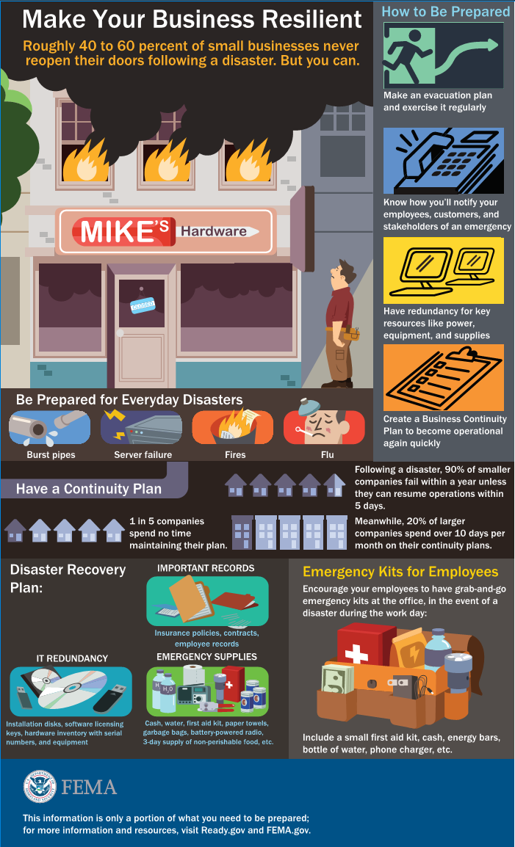
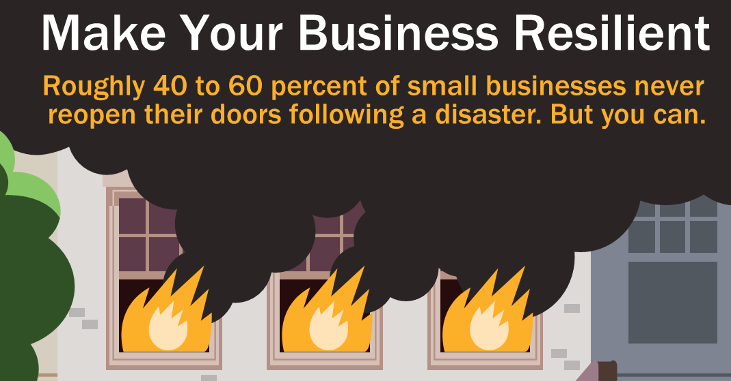

Slide 20
Targets for MCFP Systems
Early detection → Early response
Have manual extinguishers available
Accurate detection → Minimize false alarms
Notification of occupants
Appropriate automatic suppression
Limit fire size and thermal damage
Extinguish, reduce, or minimize manual firefighting
Post-fire cleanup efforts are understood
Interface for timely shutdown of processes

Slide 21
Typical Fire Growth and Detection Response
Notes:
Fire progression is generally comprised of four stages, which include the Incipient, Growth, Fully Developed and Decay stages:
The incipient stage, which quite frequently could be the progression of equipment or component degradation or failure, overheating of cabling and similar such events, in some cases could occur over the course of hours or even days before the outbreak of flame ignites. Smoke development in this stage is generally not visible to the human eye, has considerably low heat release rates being extremely buoyant with migration easily influenced by air currents.
Following the Incipient stage is the Growth stage, which could be expected to increase quite rapidly leading to the Fully Developed stage.
As fires grow in size the energy release rate increases to peak value and once fully developed, fighting fires becomes significantly more difficult and the consequences potentially much more severe.
Smoke detection categories will be related to how far an event develops before it is detected.

Slide 22
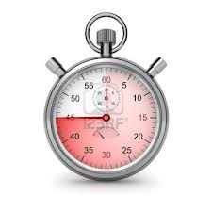
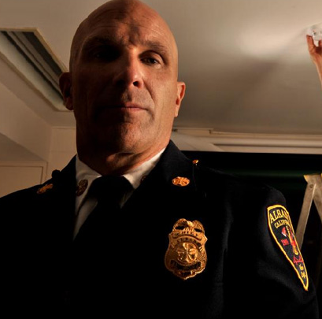
What would you do if you had time?
Responsible Human Response – Insipient Stage
Investigate, don’t evacuate
Owner response, not the fire department
Prevent unnecessary discharges
Early Detection Gives You Response Options
Time to investigate and respond
Respond proportionately to known level of risk
Manage the risk before it escalates
Investigate with thermal imaging
Shut down processes
Equipment-level power off
Use portable fire extinguishers
Notes:
Once the fire department shows up, there incident can often become a runaway train. In many cases, you will lose control of your building to them.

Slide 23
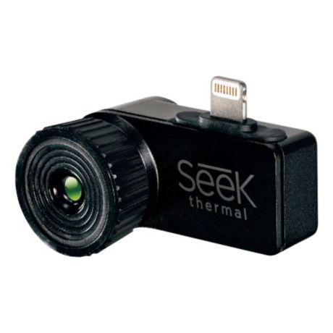
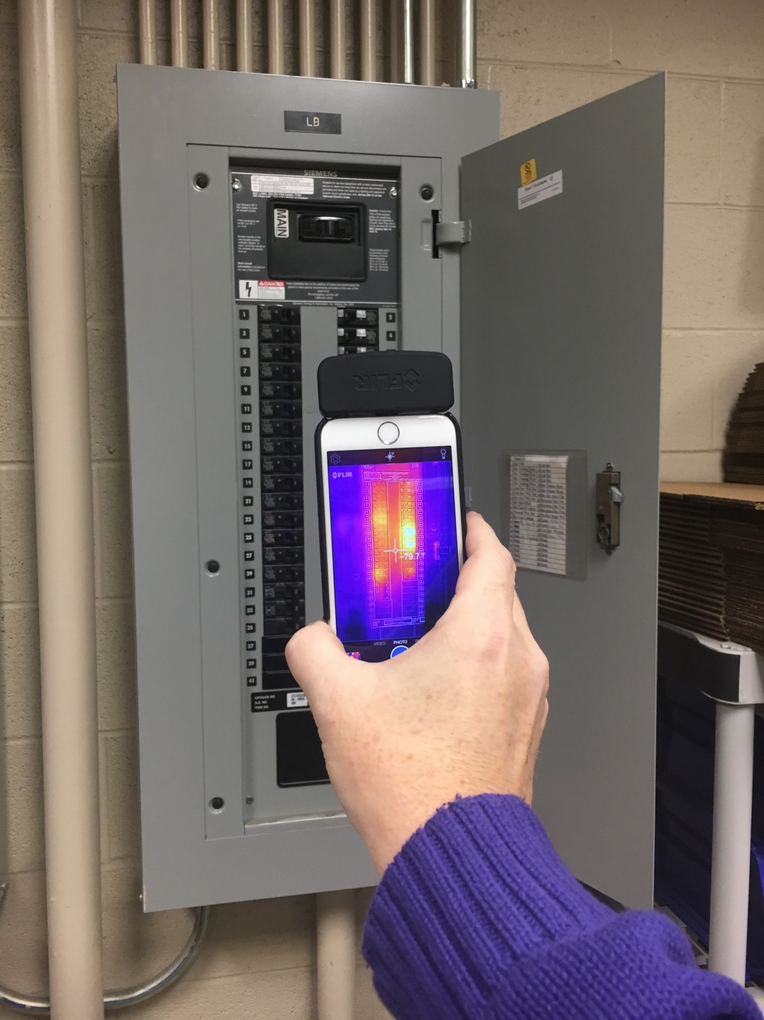
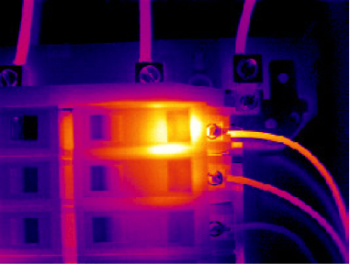
Investigations
Look for overheated equipment
Most likely ignition source for a fire
Use thermal imagers
Notes:
FLIR One for iPhone or Android $250 – Consumer grade thermal imaging

Slide 24
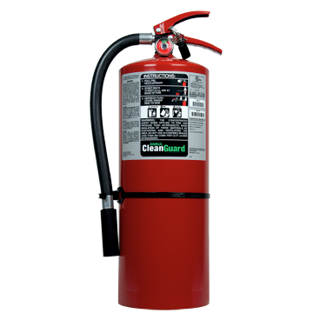
Manual Intervention – DC&Telco
Manual intervention for small fires
Locate thermal condition
Shut down processes
Power down equipment
Use an extinguisher on visible flames
Portable fire extinguisher guidance
Use Clean Agent or CO₂ extinguishers
3,000 ft² spacing
75 ft max. travel distance
Locate at room entrances
Provide training to workers

Slide 25
MCFP Strategies
Fire Sprinkler Systems
Limit the size of the fire
Allow for occupant egress
Life safety and structural protection
Limit damage to the fire compartment
Save life and the building
Extinguishing Systems
Asset protection and fast restoration
Detect quickly and activate early
Extinguish the fire
Limit the fire damage to point of origin
Minimize downtime

Slide 26
System Performance Levels
Fire Control: Limiting the size of a fire by distribution of water so as to decrease the heat release rate and pre-wet adjacent combustibles, while controlling ceiling gas temperatures to avoid structural damage
Fire Suppression: The sharp reduction of the rate of heat release of a fire and the prevention of regrowth
Fire Extinguishment: The complete suppression of a fire until there are no burning combustibles
SOME FIRE LEFT
SOME COMBUSTION
LEFT
NO COMBUSTION

Slide 27
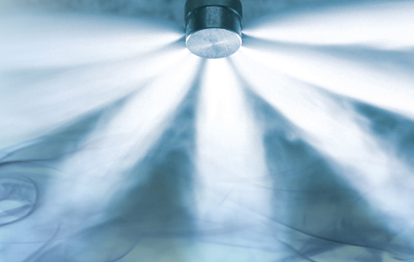
Suppression Terminology
Total Flooding System: Agent floods a defined volume, usually a room, to extinguish fire anywhere in the protected volume
Local Application System: Agent is discharged over/into a defined area or volume to protect a certain hazard within a larger volume

Slide 28
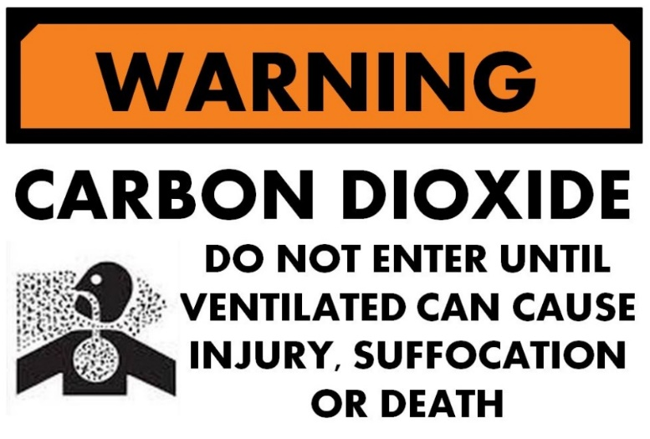
Suppression Terminology
Normally Occupied Space: Humans present under normal circumstances
Normally Unoccupied Space: A space not normally occupied but could be entered occasionally by one or more persons for brief periods
Occupiable Space: A space that has dimensions and physical characteristics such that it could be entered by a person

Slide 29
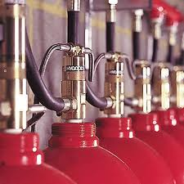
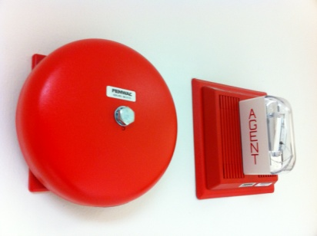
Clean Agent Systems 101
Extinguishment Without Water
Gaseous total flooding
Fast and effective
Safe for Equipment and Personnel
Electrically nonconductive
No residue
5 minute exposure limit
The Benefits
Early activation while the fire is small
Penetrates all shielded spaces and into components
Extinguish fires and minimize damage
No cleanup and fast restoration of service

Slide 30
Clean Agent System Potential Damage
Ceiling tiles blown out around nozzle
Dust in room disturbed
HDD damage in noisy installations

Slide 31
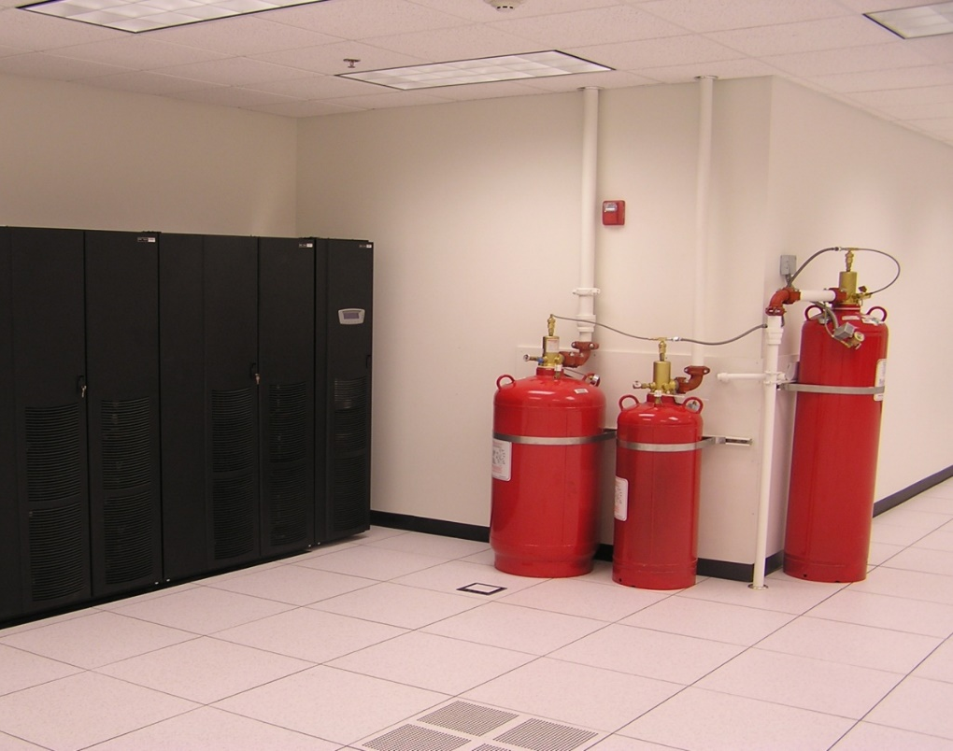
Clean Agent System Potential Damage
Accidental or malicious activations
Emergency interlocks upon discharge
Power shutdowns (EPO)
HVAC shutdowns

Slide 32
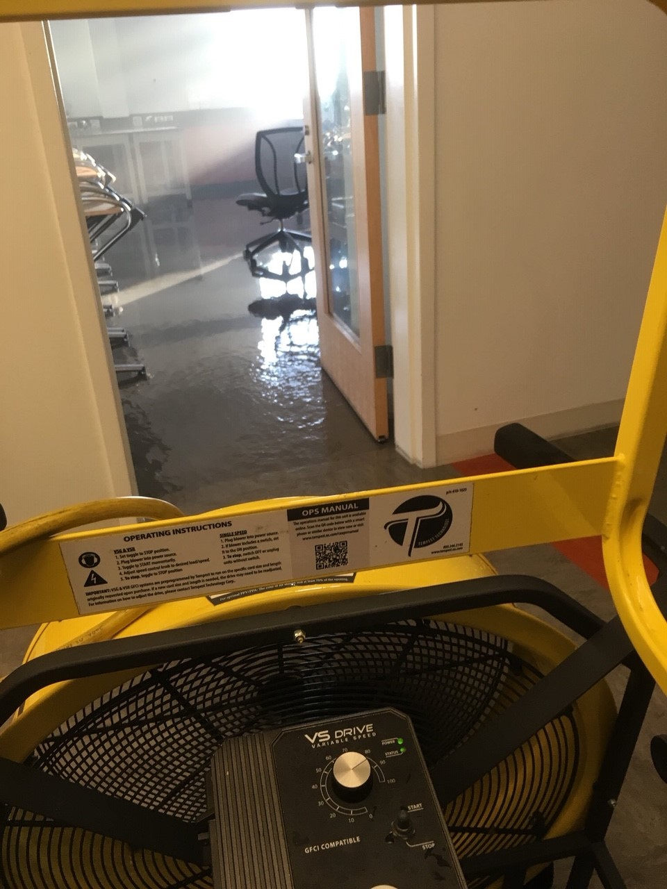
Sprinkler Damage After Activation

Slide 33
Sprinkler Damage After Activation
Slow to activate during a fire – high heat
Single sprinkler discharges 20-30 gallons per minute
An issue for multi-story structures
Collateral damage from water runoff can exceed the fire damage
Shutdown of water supply after a discharge can take time if untrained
Sprinkler systems can leak

Slide 34
Controlling Water Runoff
NFPA 75 (2017) Standard for the Fire Protection of Information Technology Equipment
Requirements for handling leaks under raised floors
Allow for removal of leaks – HVAC, plumbing, fire
Use one of these methods
Floor drains
Liquid containment with removal pumps
Use a leak detection system for concealed spaces
Recommendations
Seal floors in multi-story buildings watertight and have drains
Supervise leak detection system with FACP or BAS

Slide 35
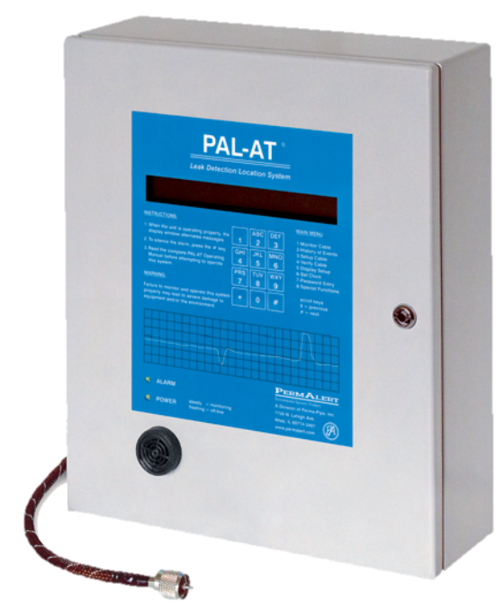
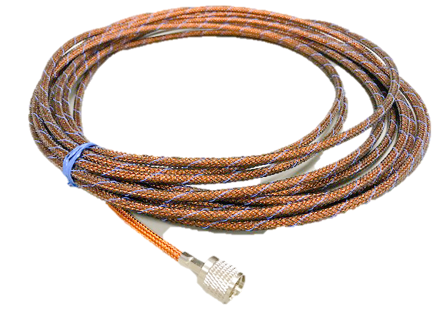
Leak Detection Cable

Slide 36
Special Hazards Systems for MC
Clean Agents
Water Mist
Carbon Dioxide
Dry Chemical
Foam Systems
Preaction Sprinkler
Water Spray/Deluge
Hybrid Systems
Encapsulators

Slide 37
Morning Break

Slide 38
10 Minute Break
Please Be Seated… We are going to START!
30
Seconds
1¹/2
Minutes
9
Minutes
4
Minutes
2
Minutes
1
Minute
7
Minutes
5
Minutes
3
Minutes
10
Minutes
8
Minutes
6
Minutes

Slide 39
Targets for MCFP Systems
Early detection → Early response
Have manual extinguishers available
Accurate detection → Minimize false alarms
Notification of occupants
Appropriate automatic suppression
Limit fire size and thermal damage
Extinguish, reduce, or minimize manual firefighting
Post-fire cleanup efforts are understood
Interface for timely shutdown of processes

Slide 40
Typical Fire Growth and Detection Response
Notes:
Fire progression is generally comprised of four stages, which include the Incipient, Growth, Fully Developed and Decay stages:
The incipient stage, which quite frequently could be the progression of equipment or component degradation or failure, overheating of cabling and similar such events, in some cases could occur over the course of hours or even days before the outbreak of flame ignites. Smoke development in this stage is generally not visible to the human eye, has considerably low heat release rates being extremely buoyant with migration easily influenced by air currents.
Following the Incipient stage is the Growth stage, which could be expected to increase quite rapidly leading to the Fully Developed stage.
As fires grow in size the energy release rate increases to peak value and once fully developed, fighting fires becomes significantly more difficult and the consequences potentially much more severe.
Smoke detection categories will be related to how far an event develops before it is detected.

Slide 41
Air Sampling Smoke Detection

Slide 42
Fire Growth Curves

Slide 43
Fire Growth Curves

Slide 44
Fire Growth Curves

Slide 45
Fire Growth Curves

Slide 46
Fire Detection Methods
Heat detection
Smoke detection
Specialty detection
Manual detection

Slide 47
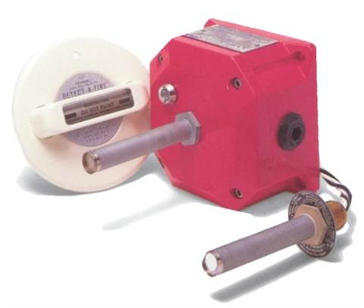
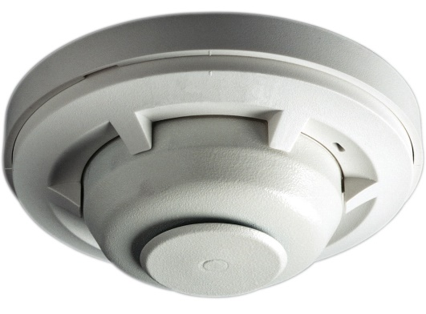
Heat Detection
Heat detectors are mounted at or near the ceiling of a room and detect the heat from a fire.
They detect either an abnormally high temperature or rate-of-temperature-rise, or both.

Slide 48
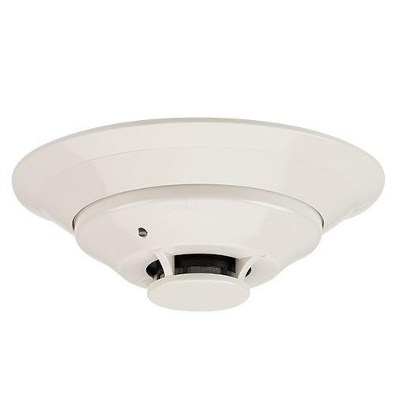
Smoke Detection
Smoke detectors can detect visible or invisible particles of combustion (smoke)
Smoke detectors are mounted at or near the ceiling of a room where smoke will travel
Smoke detectors are used to detect smoke in ductwork (duct detectors)

Slide 49
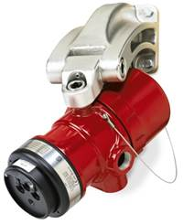
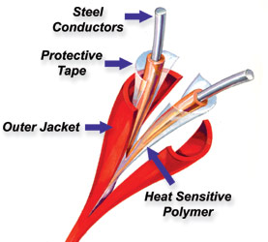
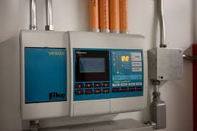
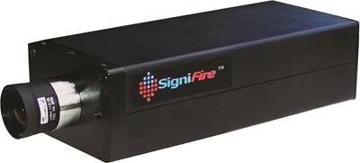
Specialty Detection
Linear heat detectors (heat detection cable)
Optical flame detectors
Video image smoke and flame detectors
Air sampling smoke detectors

Slide 50
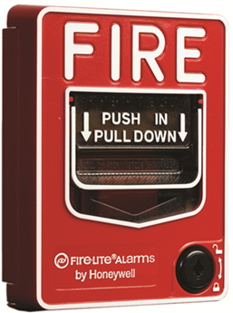
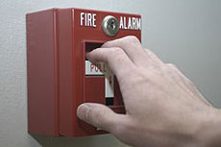
Manual Detection
When occupants of a building sense a fire they can initiate a fire alarm – or release a suppression system – at manually operated devices
Manual fire alarm box (Pull station)

Slide 51
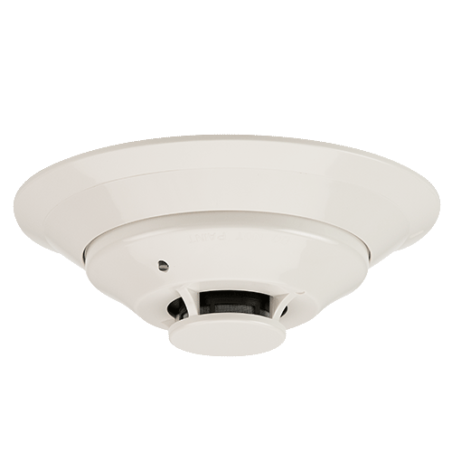
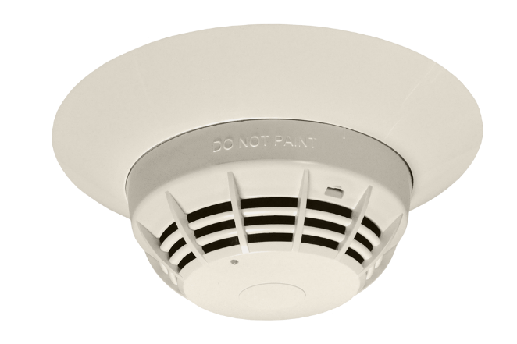
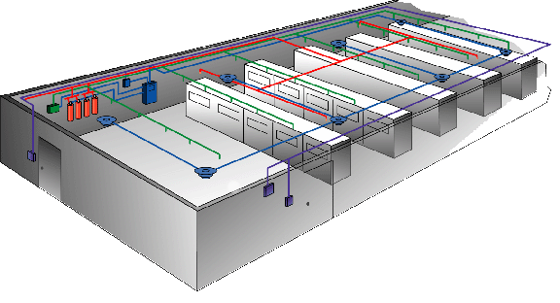
Detection Cross Zoning
Cross zone approaches
By zones
By detector types
Counting zone
Used by addressable panels

Slide 52
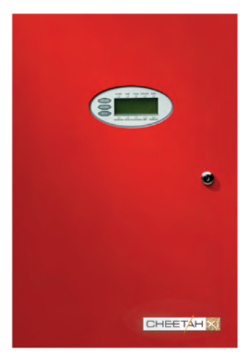
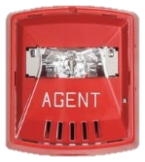
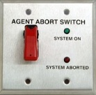
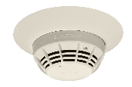
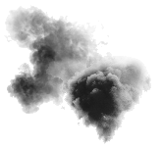
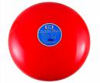
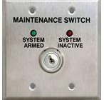
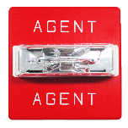
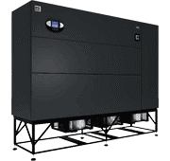
Clean Agent System Sequence
Typical Arrangement – Counting zone
Manual Release
Station
Abort Switch
Smoke Detectors
First Alarm
(Building alarm)
SLC
NAC 1
Second Alarm (Pre-discharge)
NAC 2
Disconnect Switch
Releasing Circuit
NAC 3
Discharge Alarm
Relay Outputs
Power, HVAC, and Damper Shutdowns
Notes:
If you understand this you’ll do great on the test at the end of the presentation.
FINAL SLIDE
Recap: Okay we’ve given you a baseline knowledge about fire systems in this section including
3 conditions at the panel
Panel types and common circuits
and how some fire systems are put together
Now we’re going to use the next section to show you some things that can go wrong with the system, things that can cause a trouble condition.

Slide 53
Visibility in Smoke
0.05% obs/ft
97% visibility
0.5% obs/ft
75% visibility
1.0% obs/ft
50% visibility
2.0% obs/ft`
0% visibility
Notes:
Obscuration - A reduction in the atmospheric transparency caused by smoke, usually expressed in percent per foot.

Slide 54
Air Sampling Detectors - VESDA
Detector Notification Level | Alarm Panel Response
Normal | No Fire Alarm
Alert | Pre-Warning – No Fire Alarm (supervisory signal)
Action
Fire 1 | Warning – Fire Alarm
Fire 2
ASDs have pre-warning notifications of smoke buildup and multiple alarm warnings

Slide 55
Targets for MCFP Systems
Early detection → Early response
Have manual extinguishers available
Accurate detection → Minimize false alarms
Notification of occupants
Appropriate automatic suppression
Limit fire size and thermal damage
Extinguish, reduce, or minimize manual firefighting
Post-fire cleanup efforts are understood
Interface for timely shutdown of processes

Slide 56
Notification for Mission Critical
Warns early
Before the building must be evacuated
Warns key personnel
Ones that can do something to avoid a problem
Key personnel
Warns for multiple events
Other emergencies than fire

Slide 57
Notification for Mission Critical

Slide 58
Timely Shutdowns
Fuel
Power
HVAC
Ventilation
Process

Slide 59
Edge Computing and IoT

Slide 60
Edge Computing and IoT
Notes:
Electric cars
Self-driving cars – Waymo owned by Google
Tesla’s self-driving electric semi
Autonomous Delivery drones – Wake County NC to deliver medications tested in Summer of 2018

Slide 61
Edge Computing and IoT
Data processing to support IoT will be rapidly growing
Computing must be close to the devices they support to keep the speed high
Concept of “Edge Computing”
In the next five years…
Thousands of small data centers
Distributed throughout the U.S.
All will need a credible fire protection strategy

Slide 63
Edge Computing and IoT
Data processing to support IoT will be rapidly growing
Computing must be close to the devices they support to keep the speed high
Concept of “Edge Computing”
In the next five years…
Thousands of small data centers
Distributed throughout the U.S.
All will need a credible fire protection strategy

Slide 64
Telecom Predictions
Telecommunications Central Offices are becoming data centers
Telco switching equipment is becoming IT equipment
Increased number of connections will need to be handled
Need for data processing to be near the connectivity telco facilities offer
Suppression changes
Telco facilities often don’t have suppression
Data centers have suppression
Notes:
In many populated areas the communications cables, hardened building infrastructure, and suitable floor space is going to be a great place to place data processing equipment

Slide 65
Energy Storage Systems
Two converging technologies
Better batteries – lithium-ion
Plentiful renewable energy sources
Big shift coming in the energy grid
On-site energy storage
Utility scale energy storage

Slide 66
On-Site Energy Storage

Slide 67
Grid Scale Energy Storage

Slide 68
Energy Storage Systems
Battery Failure and Battery Damage
Thermal Runaway
Off-Gassing of Electrolyte
Battery Fire – Single Cell
Catastrophic Explosion and Fire – Multiple Cells

Slide 69
Li-Ion Battery Fire Protection
Still a Moving Target
No clear winner in fire extinguishment yet
Special hazard systems can delay explosion
Current strategy 2019
Protect against fire exposure to the batteries
Gas detection
Aspirating smoke detection
Fire extinguishing systems – clean agent

Slide 70
Future Needs of Fire Protection
What will the future of MCFP look like?

Slide 71
Future Needs of Fire Protection
Combination of Environmental Sensors, Fire, and Gas Detection
Temperature
Humidity
Air quality – particulate
Explosive atmosphere
Video – flame, smoke, motion, hot surfaces (thermal imaging)
Smoke
Notes:
Combination of Environmental Sensors and Fire and Gas Detection
Temperature
Humidity
Air quality – particulate
Explosive atmosphere
Video – flame, smoke, motion, hot surfaces
Smoke

Slide 72
Future Needs of Fire Protection
Internet Connectivity of Systems
Report status to mobile connections
Tied in with building access system
Use sensors to measure changes driving towards predictive maintenance cycles

Slide 73
Future Needs of Fire Protection
Suppression Systems are Ripe for Innovation
More supervision to warn about tampering or human-caused impairment
More self-testing features built into systems driving down the need for inspections and testing
Integration with ongoing fire detection for cycling on/off of the suppression system
New extinguishing agents

Slide 74
QUESTIONS?

