Slide 1
Minimize Fire Risk
and Maximize Recovery

Slide 2
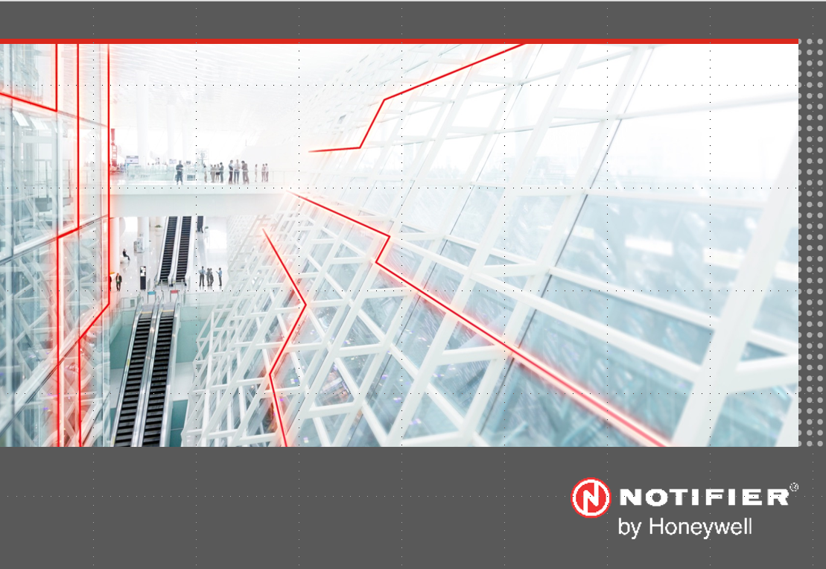
ERCES / Bi-Directional Amplifier (BDA) Systems
Dave Tamulevich
January 2019

Slide 3
Emergency Responder Communications
Enhancement System (ERCES)
In-Building Emergency Responder Radio
Coverage Enhancement Systems (IBERRCES)
Bi-Directional Amplifier (BDA) SYSTEMS

Slide 4
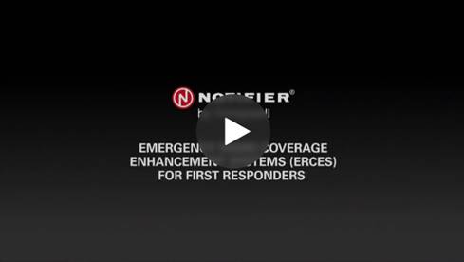
A short intro to Emergency Responder Radio Coverage
Enhancement / BDA Systems

Slide 5
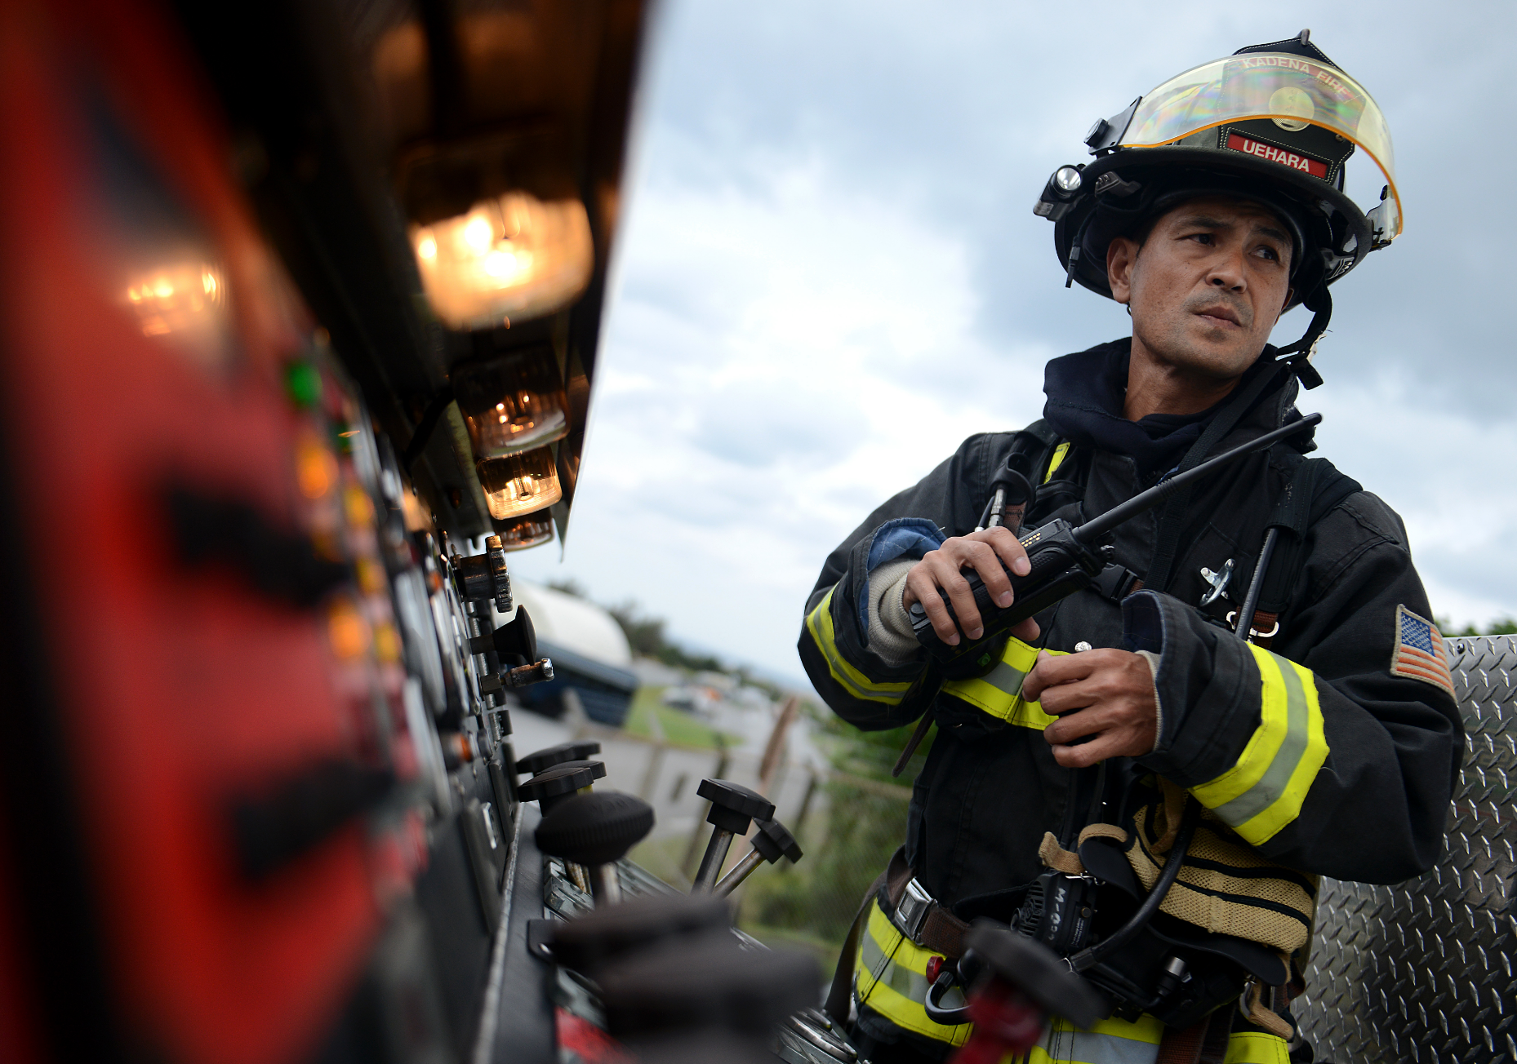
Public Safety Radio
  “Reliable Radio Coverage is a Necessity!
  Lives Depend on It!”

Slide 6

The Problem: In-Building Radio Signal Degradation
Radio signals are attenuated by:
Concrete, Metal & Other Materials
Low-E Glass
Below-Ground Structures
Other Obstructions
Radio Frequency Interference
The consequence:
Poor in-building Fire Fighter radio signal coverage and “dead spots”
Emergency responders lose communications

Slide 7
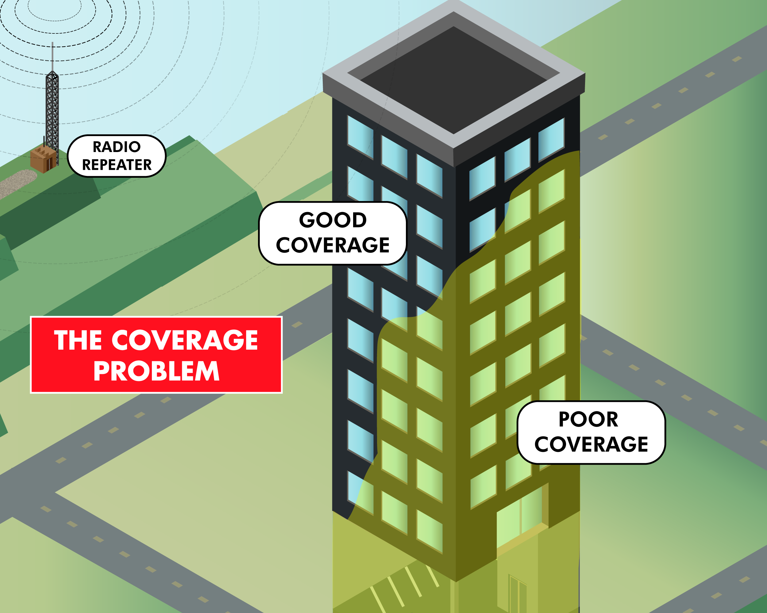
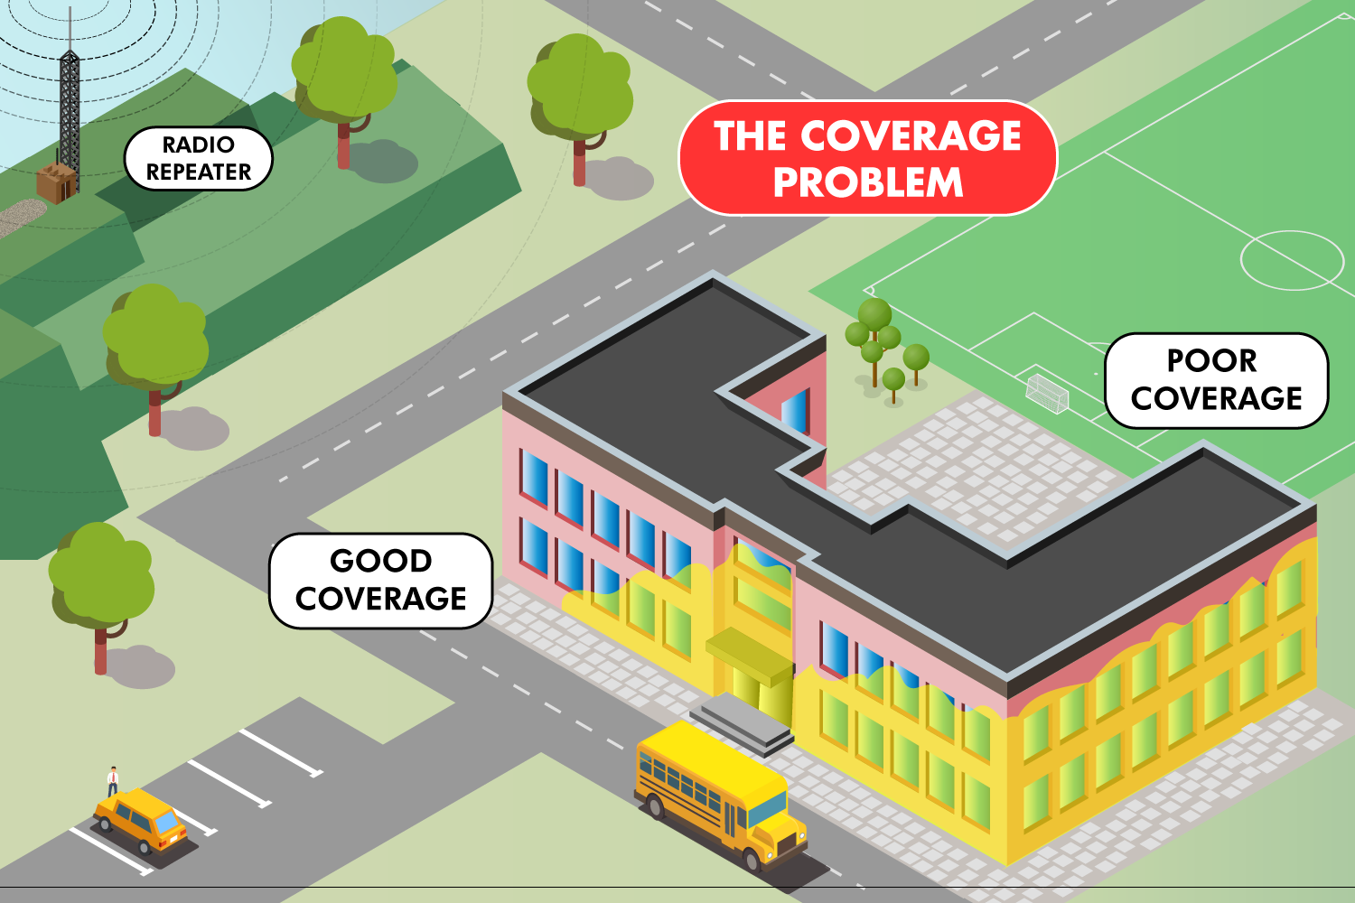
The Coverage Problem

Slide 8
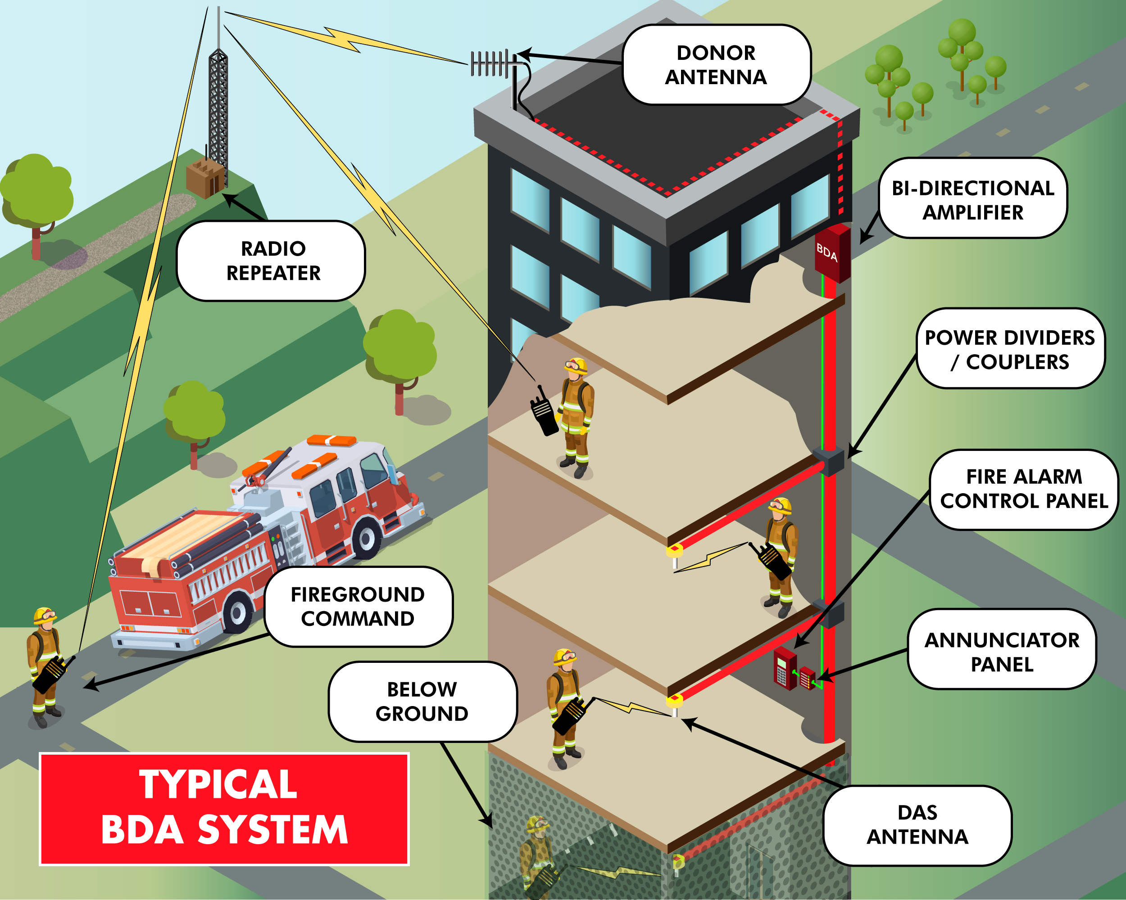
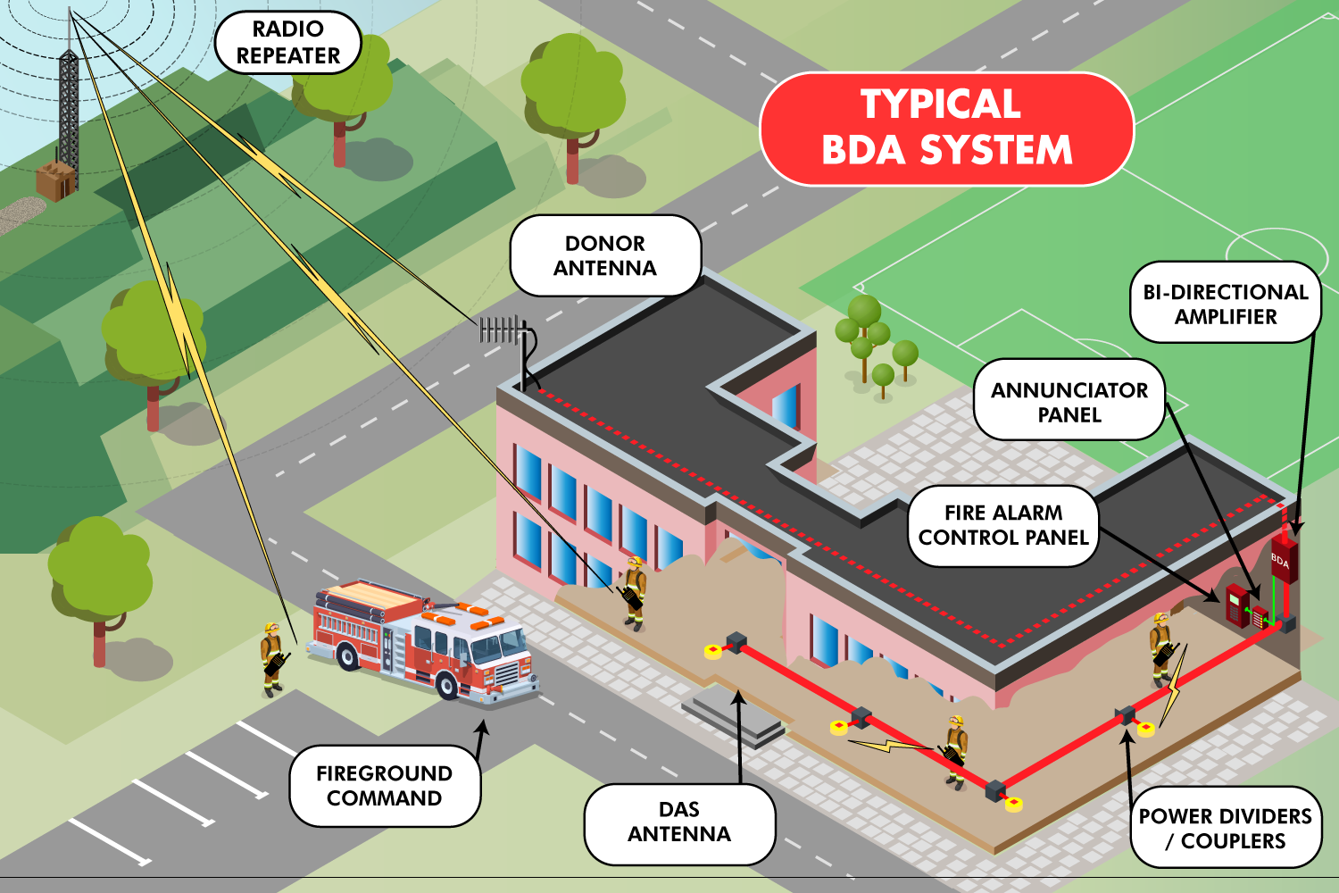
ERCES/BDA
The Coverage SOLUTION

Slide 9

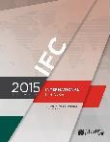
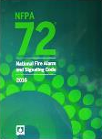
Life Safety Benefits of BDA Systems: Codes & Standards
IBC 2015 - Section 916, NFPA 1 Section 11-10
Refers to IFC section 510 or the state recognized fire code
IFC Section 510 Emergency Responder Radio Coverage
First appeared in the appendix of the 2009 IFC; the provision was moved to the body of the code in 2012.
At present 24 states have adopted the 2012 edition of the IFC and 12 states have adopted the 2015 edition of the IFC.
Section 1103.2 specifies the requirements for emergency responder radio coverage in existing buildings.
NFPA 72 National Fire Alarm and Signaling Code
2010 / 2013 Edition, section 24.5.2
The 2016 edition of NFPA 72 relocated the requirements to NFPA 1221
2016 & 2019 Editions of NFPA 1221, Emergency Service Communications Systems, Section 9.6

Slide 10
IFC 510 Coverage Requirements
510.4.1 Radio signal strength.
The building shall be considered to have acceptable emergency responder radio coverage when signal strength measurements in 95 percent of all areas on each floor of the building meet the signal strength requirements in Sections 510.4.1.1 and 510.4.1.2.
510.4.1.1 Minimum signal strength into the building.
A minimum signal strength of -95 dBm shall be receivable within the building.
510.4.1.2 Minimum signal strength out of the building.
A minimum signal strength of -95 dBm shall be received by the agency’s radio system when transmitted from within the building.

Slide 11
NFPA Coverage Requirements
Critical Area Coverage – 99% (NFPA 2013 / 2016) coverage required in
Critical areas:
  Emergency Command Center(s) Fire Pump Room(s)
  Exit Stairs Exit Passageways
  Elevator Lobbies Standpipe Cabinets
  Sprinkler Sectional Valve Locations
General Area Coverage – General building areas should have 90%
Dedicated Monitoring Panel - independent of the fire panel, within the emergency command center to annunciate the status of any signal booster(s) with visual and labeled indication of the following for each signal booster:
  Normal AC power Signal booster trouble
  Loss of normal AC power Failure of battery charger
  Low-battery capacity Antenna failure

Slide 12
AHJ Concerns About ERCES
Improper installation or a failure could lead to oscillation (donor antenna signal feeds back into the DAS), creating harmful interference to Public Safety Radio System.
Noise on uplink can potentially add up & cause signal degradation for firefighter radio systems.
Failure of A System Component may go unnoticed without proper monitoring & supervision (required by NFPA 1221), resulting in the system NOT being available when you need it most.
“Competency” of System Designer & Installer
How do AHJs specify & ensure compliance?

Slide 13
The SOLUTION:
UL 2524-Listed ERCES/BDA System
Oscillation Suppression
BDA Detects Oscillation & Reduces Gain in 5dB steps until no further oscillation
BDA Sends Trouble Signal to Fire Alarm Control Panel
BDA Indicates Trouble on Remote Annunciator / Monitor
BDA Continues normal operation with the maximum allowable gain
Noise Suppression
Most BDAs normally generate a small amount of noise when idle.
The cumulative effect of all this noise raises the “noise floor” on a frequency.
NOTIFIER BDAs operate in “stand-by mode” and do not transmit any noise while idle.
NOTE: IFC 2018 requires Bi-Directional Amplifiers (BDAs) used in emergency responder radio coverage systems shall have oscillation prevention
circuitry. IFC 2021 requires Active RF emitting devices used in emergency responder radio coverage systems shall have built-in oscillation
detection and control circuitry.

Slide 14
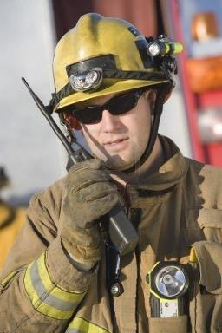
Compliance, Safety and Reliability
= UL 2524
IFC & NFPA Compliance
  Supervision & Monitoring
  UL-Listed Power Supplies
  Battery Backup (24 hrs @ 20% derated)
  Monitoring of Secondary Power Supply
  Type 4 Enclosure (certified as an assembly)
  Supervised dedicated monitoring panel
Electric Shock & Fire Safety (UL 60950)
Product Reliability (O.O.I. & 1st Edition)
FCC Compliance
Oscillation Suppression

Slide 15
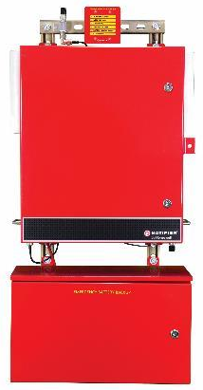

Each UL2524 Listed BDA is installed by Factory-Certified Life Safety Systems Technicians with F.C.C. G.R.O.L. Licenses as required by IBC/IFC.
Standardized Training, Tools & Equipment, Standardized Design Process (using iBwave software)
Each ERCES system design is either certified or done by the manufacturer
Proficiency ensures that the entire system meets Honeywell’s Quality Standards
Elements of a TRUE Life
Safety ERCES/BDA System
2524

Slide 16
CERTIFICATE OF COMPLIANCE
Certificate Number 20180608-S36081
Report Reference S36079-20180608
Issue Date 2018-JUNE-08
Issued to: NOTIFIER
12 Clintonville Rd
Northford, CT 06472-1610
This is to certify that representative samples of IN-BUILDING TWO-WAY EMERGENCY RADIO COMMUNICATION ENHANCEMENT SYSTEMS
UL Fire Alarm Equipment:
In-building two-way emergency radio enhancement system equipment , Bi-Directional Amplifier (BDA) models
NF-BDA400-1B, NF-BDA400-2B, NF-BDA150-1B
NF-BDA800-1B, NF-BDA7800-2B, NF-BDA700-1B.
Have been investigated by UL in accordance with the Standard(s) indicated on this Certificate.
Standard(s) for Safety: UL 2524, Outline of Investigation for In-building 2-Way Emergency Radio Communication Enhancement Systems
Additional Information: See the UL Online Certifications Directory at www.ul.com/database for additional information
Only those products bearing the UL Certification Mark should be considered as being covered by UL's Certification and Follow-Up Service.
Look for the UL Certification Mark on the product.

Slide 17
UL-Listing Update
2524
NOTIFIER BDAs are listed to the UL 2524 Outline of Investigation,
which was originally published Dec. 21st, 2017.
Companies that were listed to the UL 2524 O.O.I. will be “grandfathered” for eighteen (18) months, unless they make any changes in the construction of their BDAs.
UL will publish this “Continuing Certification Program” extending to May 2020.
NOTIFIER BDAs will be UL 2524 Listed for the NEXT 18 months!
October 19th, 2018, UL published an update to UL 2524 O.O.I., becoming UL2524 1st Edition, an ANSI Standard, which expanded the robustness requirements for BDA Systems.
NOTIFIER has 18 months to make any changes to its BDA systems to be compliant with the new requirements in UL 2524 1st Edition standard.
We will share the written confirmation from UL of the Continuing Certification Program as soon as it is available.

Slide 18
Integrated, All Inclusive
UL-Listed SOLUTION
This is the first Fire & Life Safety Co. to market a UL 2524 Listed, fully integrated BDA solution
The first, and the only all-inclusive, turnkey, code compliant BDA System on the market. (It is also CSFM-Listed)
Independent N.R.T.L. Testing & Verification of Performance Assures AHJs, A&Es & Building Owners that Honeywell’s BDA Systems Perform the First Time and Every Time, exactly as prescribed in IFC 510.5.3 and NFPA 1221 / 72
Oscillation Detection & Prevention
Zero-Noise Squelch Feature
2524

Slide 19

Are In-Building ERCES Regulated?
NEW UL 2524 Product Performance Listing ensures safe, reliable equipment as required by code:
Until recently, there was no certification process for ERCES systems.
UL has created a product standard by publishing an Outline of Investigation (OOI) in December 21, 2017.
NOTIFIER BDA now complies with and is listed to this new UL Standard as of June 11, 2018.
FCC-Certified
Signal Boosters must be FCC certified (manufacturer product brochures and product labels must include FCC ID number).
The end-user must ensure that all equipment is FCC-certified.
FCC will not approve a BDA for both Cellular & Land Mobile Radio.
2524

Slide 20
How do AHJs Specify & Ensure Compliance?

Slide 21
Elements of the AHJ ERCES Specification
Technical
Frequency Coverage
Radio Site Locations
Permitting Process
Testing & Acceptance
UL Listing, Regulatory Requirements
It’s a Performance-Based Specification, “no need to over-specify”
Administrative
AHJ Contact Information
Permitting & Certification Forms
Submittal Documentation Requirements
Maintenance Contract Requirements & Certifications
Applicable Code References
Installer Qualification Requirements

Slide 22
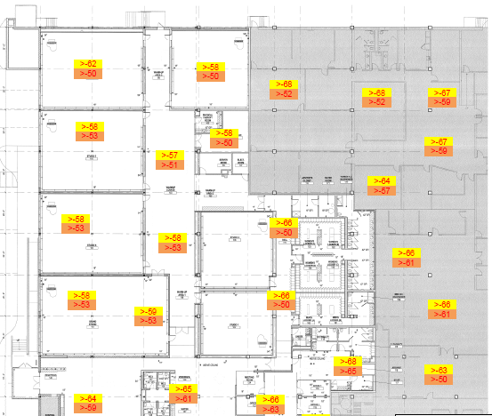
Typical Signal Survey Report

Slide 23
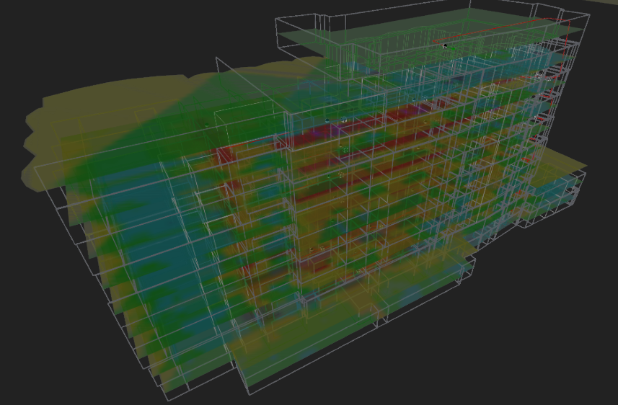
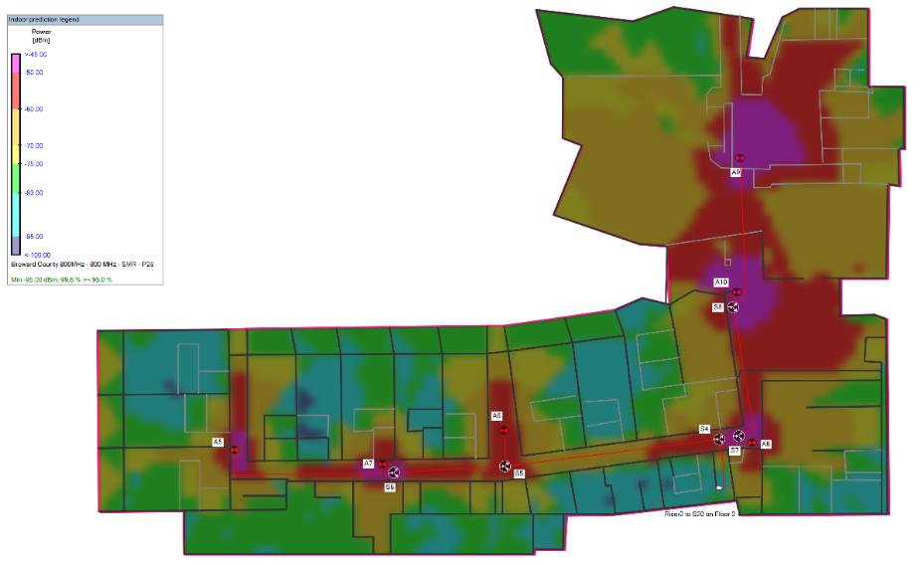
iBwave Design
Benefits of iBwave Modeling
  Signal Prediction for new construction.
  Design layout for installers.
  Submittal documentation for AHJ’s and A&E’s.

Slide 24
FCC Certification & Registration Requirements
Signal Boosters must be FCC certified (manufacturer product brochures and product labels must include FCC ID number)
BDAs are FCC certified to operate on the licensee’s frequencies
FCC Requires frequency licensees (FD, PD, municipality, etc.) to register all signal boosters that operate on their frequencies
Registration is free and FCC has a simple on-line registration tool: https://signalboosters.fcc.gov/signal-boosters
Registration needs to be done by the AHJ (frequency licensee) because it requires the licensee FRN (federal registration) number and FCC password.
BDA vendor can assist if needed

Slide 25
What is the difference? Which one is better?
Signal Boosters – Class A or Class B?
FCC classifies signal boosters as either Class A or Class B.
FCC Definitions per 47CFR90.219 rule:
Class A signal booster: “A signal booster designed to retransmit signals on one or more specific channels. A signal booster is deemed to be a Class A signal booster if none of its passbands exceed 75 kHz.”
Class B signal booster: “A signal booster designed to retransmit any signals within a wide frequency band. A signal booster is deemed to be a Class B signal booster if it has a passband that exceeds 75 kHz.”
Note: This classification is different from Class A and Class B fire alarm circuit wiring.

Slide 26
Signal Boosters – Class A vs Class B
Class A | Class B
Maximum Passband is 75KHz. Intended to amplify no more than one channel at one time | Maximum Passband is more than 75KHz. It can amplify more than one channel at the same time It can either be broadband or band-selective.
Introduces signal delay (aka “group delay”) of over 50 microseconds resulting in signal distortion and interference in signal overlap areas | Very low to negligible signal delay (usually less than 2 us). Does not introduce signal distortion and interference in signal overlap areas.
Higher power consumption, higher heat dissipation = lower efficiency | Lower power consumption, less heat dissipation = higher efficiency
Class A BDAs support Advanced Features like Noise Suppression and Automatic Uplink Squelch. | NOTIFIER Class B BDAs also offer these advanced features—without the added cost & complexity of Class A.

Slide 27
QUESTIONS?

